Slide 1



Slide 2
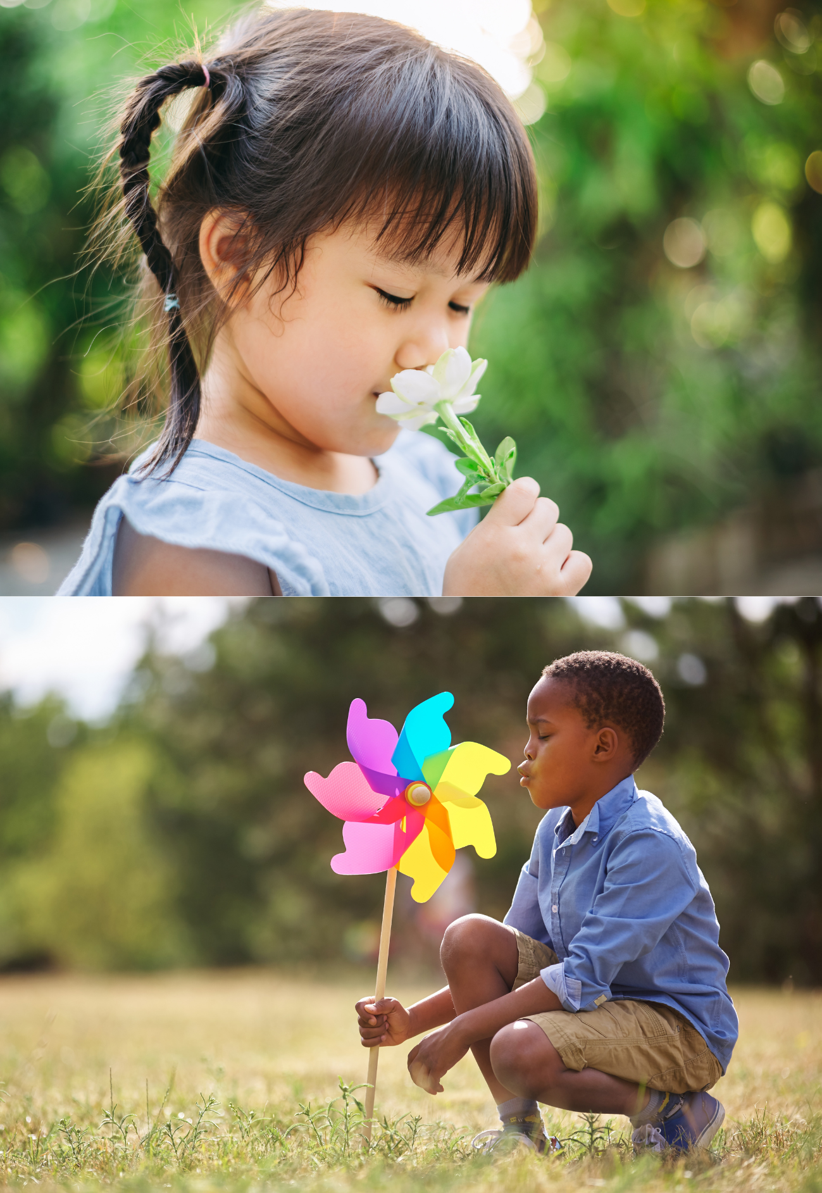
Take a Breather
Let’s use our breath to help us feel calm and happy. Clean air is so important for our bodies!​
Imagine you are holding a flower in one hand and a colourful pinwheel in the other.​
Ready? Let’s smell the flower… (Breathe in slowly through your nose, 1… 2… 3…)​
Now blow the pinwheel… (Breathe out slowly through your mouth, 1… 2… 3… 4…)​
Let’s do it together 3 times!
Repeat:​
Inhale (smell the flower) for 3 seconds​
Exhale (blow the pinwheel) for 4 seconds​
​
Well done! ​
​
We can use our breath to feel calm. ​
It’s so important to keep our air clean!

Slide 3
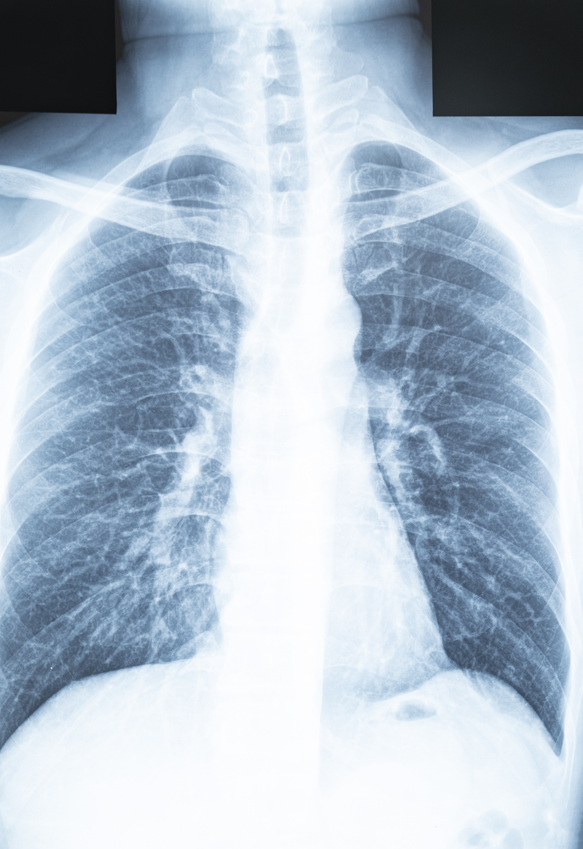
Dirty Air
Air pollution is harmful to our lungs and airways. It can make it harder to breathe. When we are exposed to air pollution over a long period of time, it can increase our risk of developing lung conditions. ​
​
Dirty air can:​
Make it harder to breathe​
Make our lungs feel poorly​
Be especially bad for children, because your lungs are still growing and developing!​
​

Slide 4
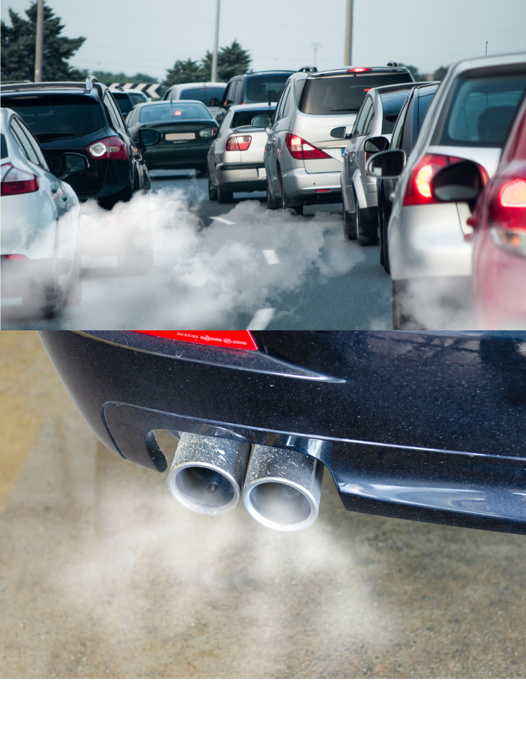
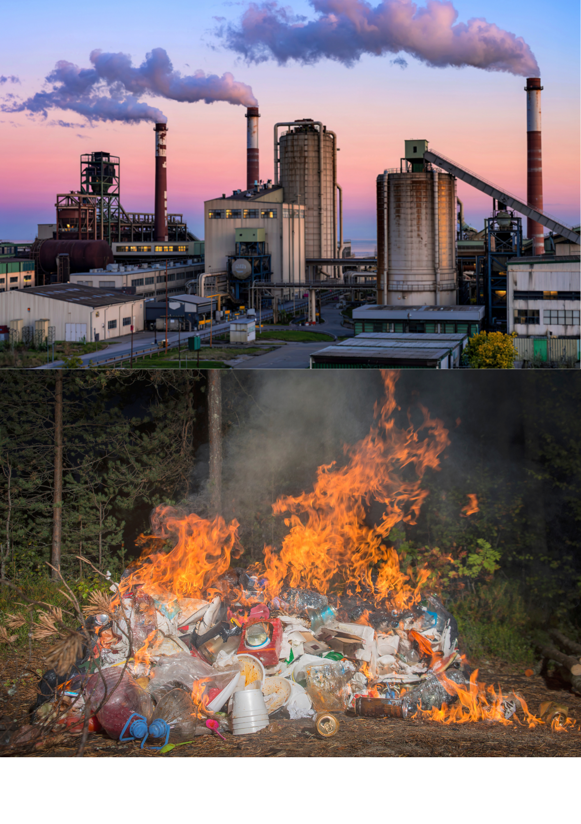
What causes air pollution around school?
Around schools, there are a few things that can make the air dirty:
Cars with engines on​
When grown-ups leave their cars running outside the school, the cars let out dirty smoke into the air.​
Lots of traffic
When many cars, buses, and vans drive past the school, they make fumes that go into the air and can hurt our lungs.
Burning things
Sometimes people nearby burn rubbish, wood or use fires, and that can put smoke into the air too.
Factories
If there are factories near the school, they might also let out smoke or gases that add to the pollution.

Slide 5
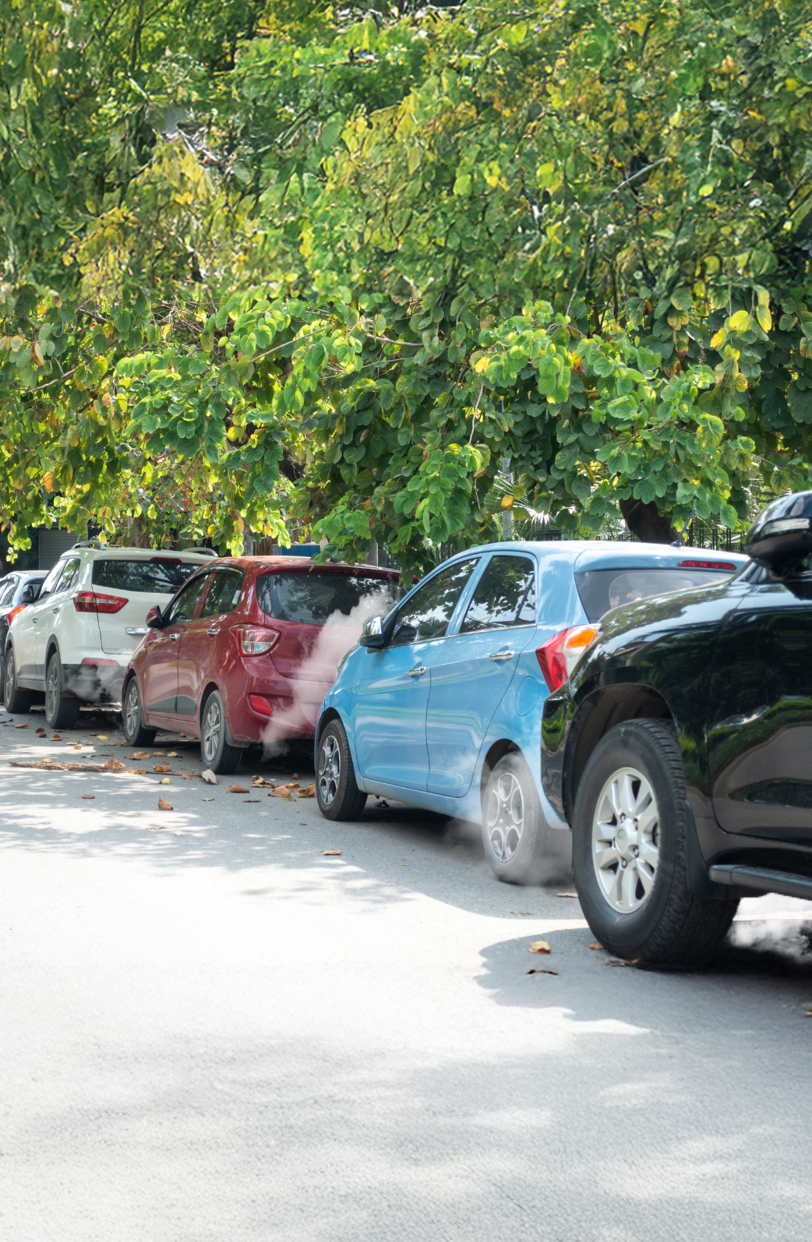
Vehicle Idling
Idling is when a motor vehicle’s engine is still running, but the vehicle is not moving.​
​
Sometimes grown-ups leave the engine on when they are waiting, like outside school or in a car park. When the engine is on, the vehicle makes dirty air, even if it’s not going anywhere.​
This dirty air is called air pollution, and it’s not good for our lungs, especially for children.​ That’s why it’s better to turn the engine off if you’re not driving – to help everyone breathe cleaner, fresher air!

Slide 6

Even inside school, there are some things that can make the air not so fresh…​

Slide 7
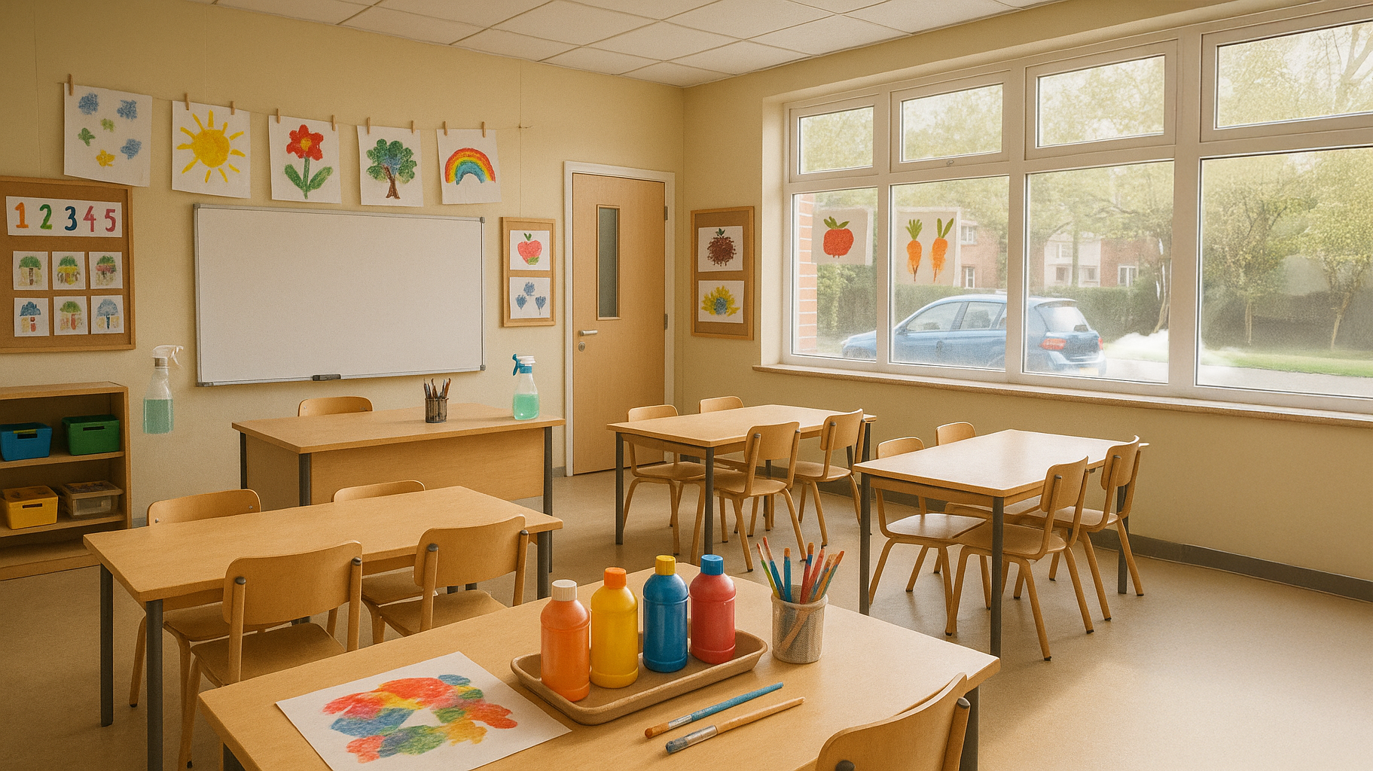

Slide 8

Strong-smelling cleaning sprays
Art supplies
Sometimes sprays and cleaners have strong smells that put little chemicals into the air. Too much can make it hard to breathe.
Some glues, paints, or markers can have smelly fumes — it’s important to use them safely and only with a grown-up’s help.
Dust
Keeping engines running near windows
If classrooms or carpets aren’t cleaned properly, dust can build up and make the air feel stuffy or make people sneeze and cough.
If someone leaves a car engine running right outside a classroom window (idling), the dirty fumes can come inside.
Poor ventilation
If windows and doors stay closed all the time, the same air goes around and around. We need fresh air to keep our lungs happy!

Slide 9
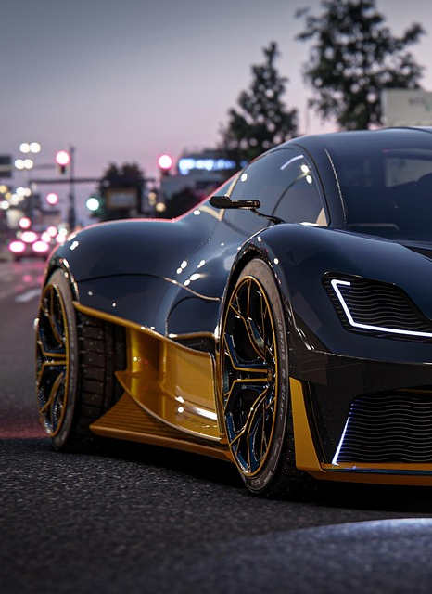

Electric Cars
​What is an Electric Car?​
An electric car is a car that runs on electricity instead of petrol or diesel (fuel).​
It has a battery inside, just like your toys or tablets, but much bigger! You charge it up like a phone, and then it can drive.​
​
Why Are Electric Cars Better for the Environment?​
No dirty fumes! ​
They’re quieter​
Kinder to the planet
Did you know?
Some electric cars can even be charged using sunshine from solar panels – isn’t that amazing!

Slide 10
So, what can we do about it?
Small Actions, Big Difference!

Slide 11
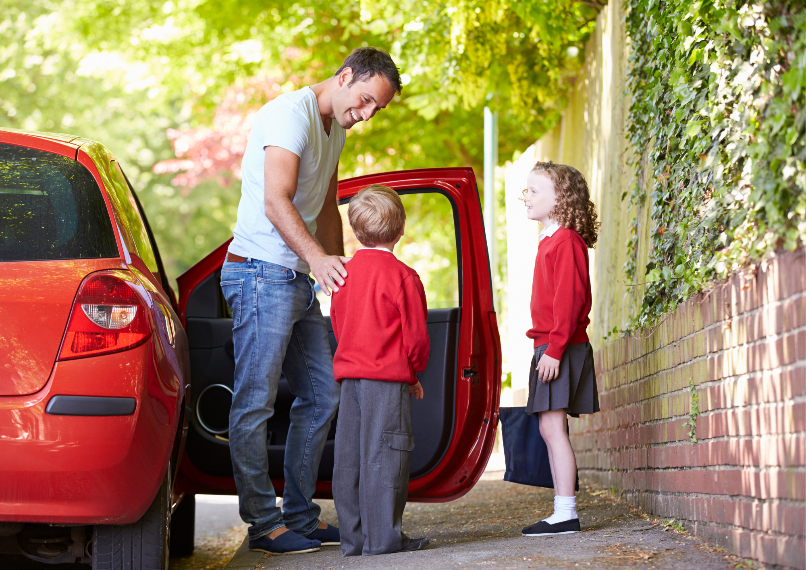

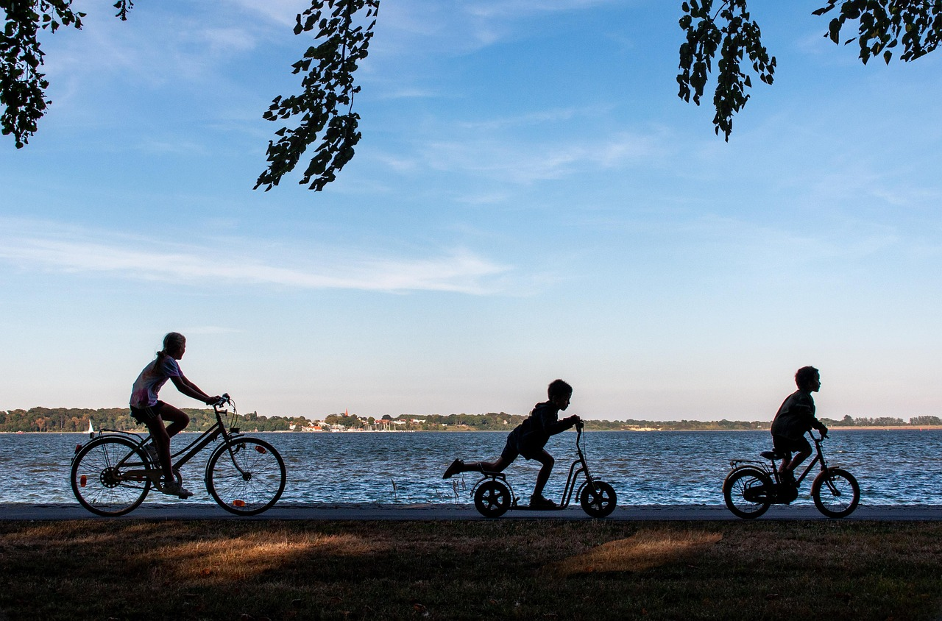
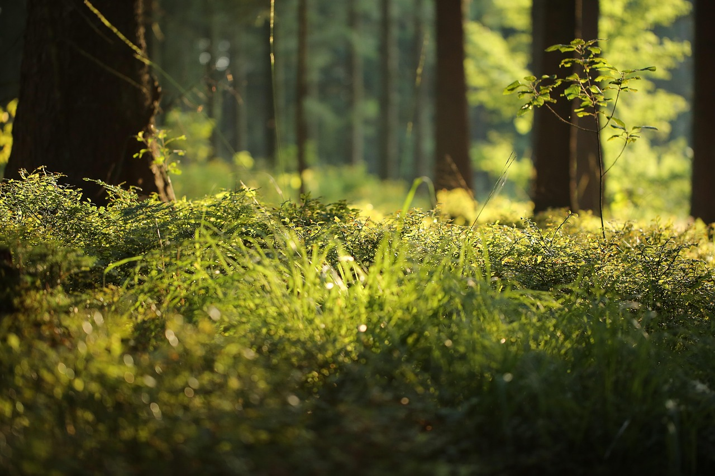
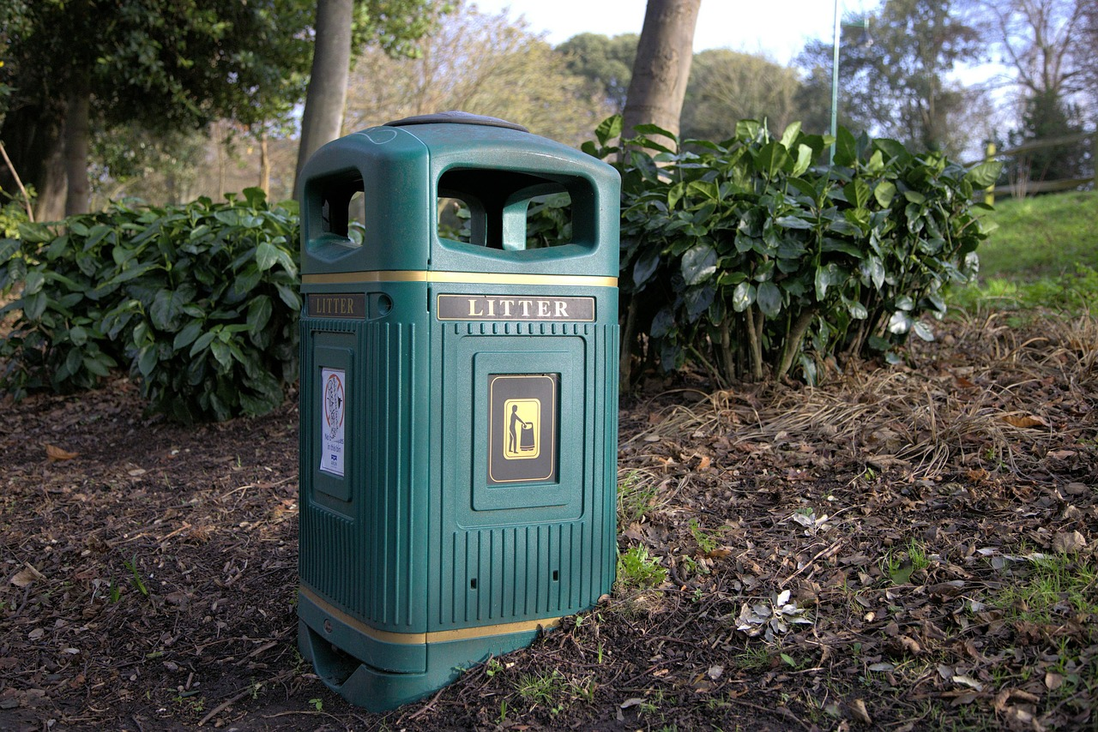
Remind grown-ups to turn off their car engine
If you see someone waiting in the car with the engine on (idling), politely remind them to switch off their engine to help us breathe cleaner air.
Look after plants and trees
Plants and trees help clean the air. You can help by planting flowers, watering plants, or taking care of green spaces at school or home.
Don’t litter or burn rubbish
Throw rubbish in the bin and never burn it. Buring waste puts dirty smoke into the air.
Walk, scoot or cycle to school​
If you can, walk, ride your scooter or bike to school instead of going in the car, it helps keep the air cleaner. ​
Be a Clean Air Champion!
Tell your friends and family what you’ve learned about clean air and why it matters. Sharing helps others make good choices, too.

Slide 12
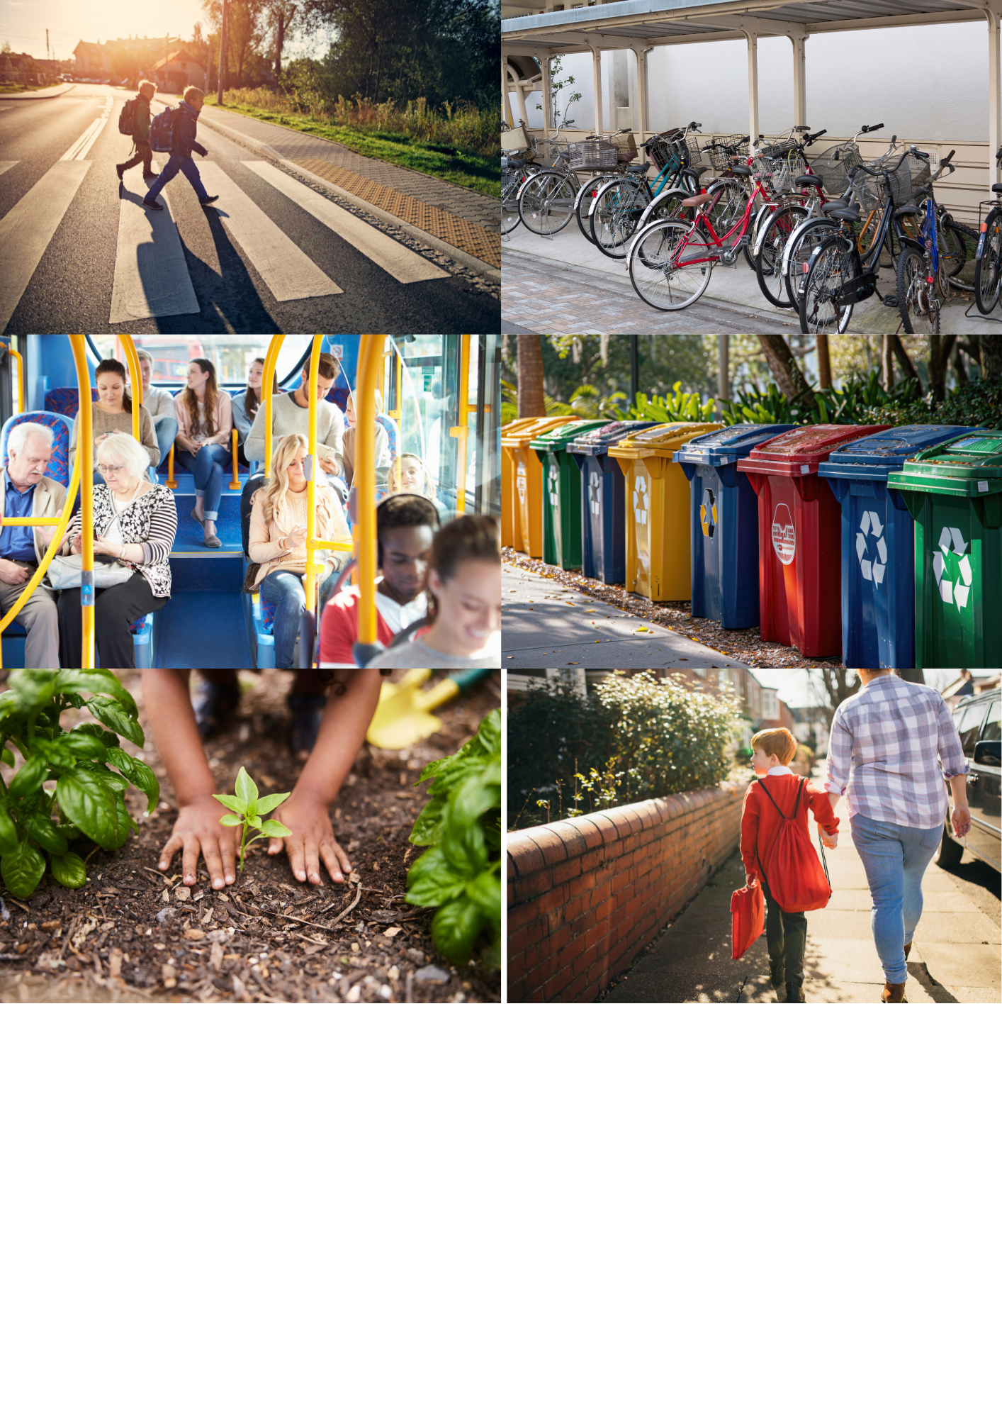
Our Clean Air Promise

Slide 13
Play Your Part!
We can all play our part in making the air we breathe cleaner and safer. ​
​
Tell your grown-ups everything you have learnt. Make sure they turn off their car engines when waiting somewhere and Idle No More!

