Slide 1
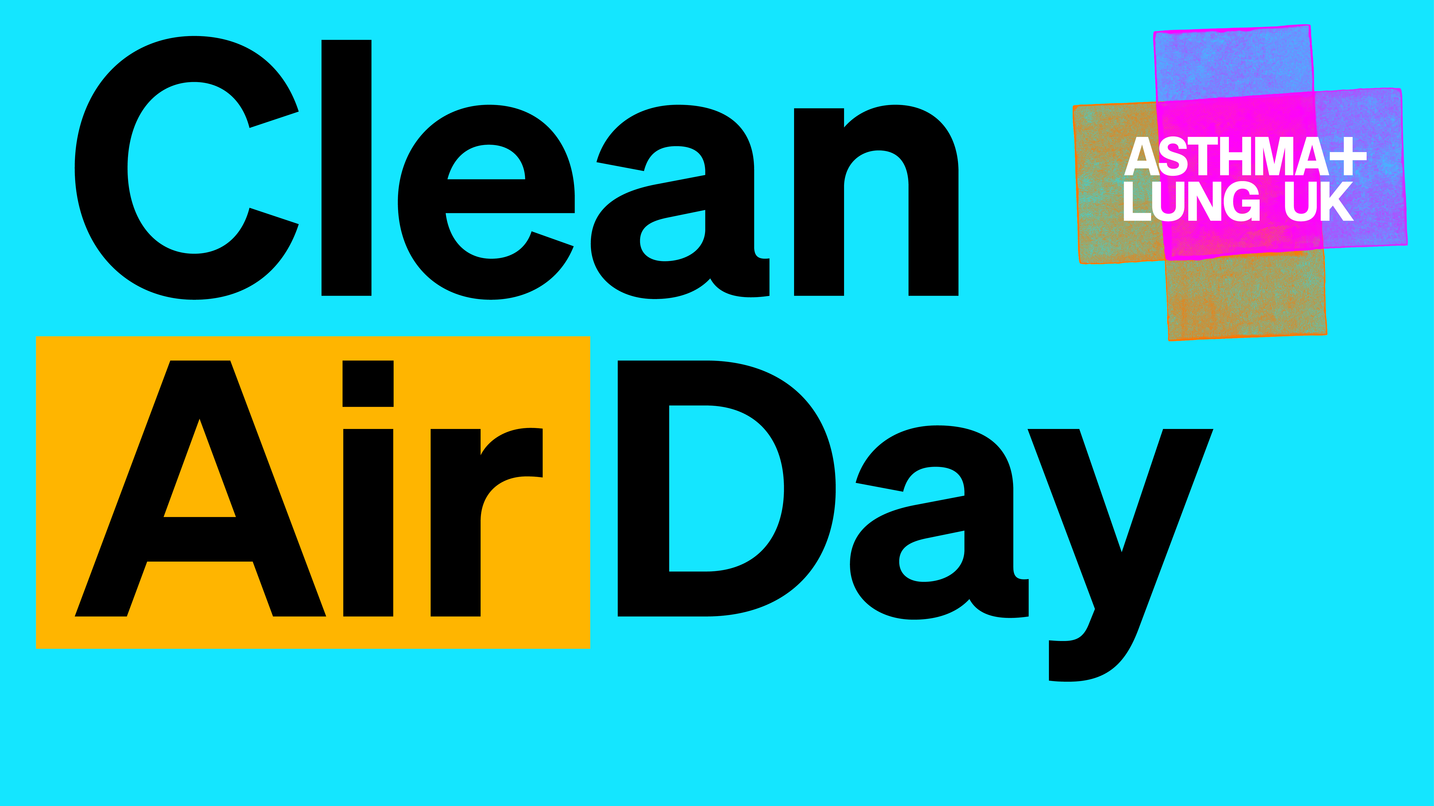

Slide 2
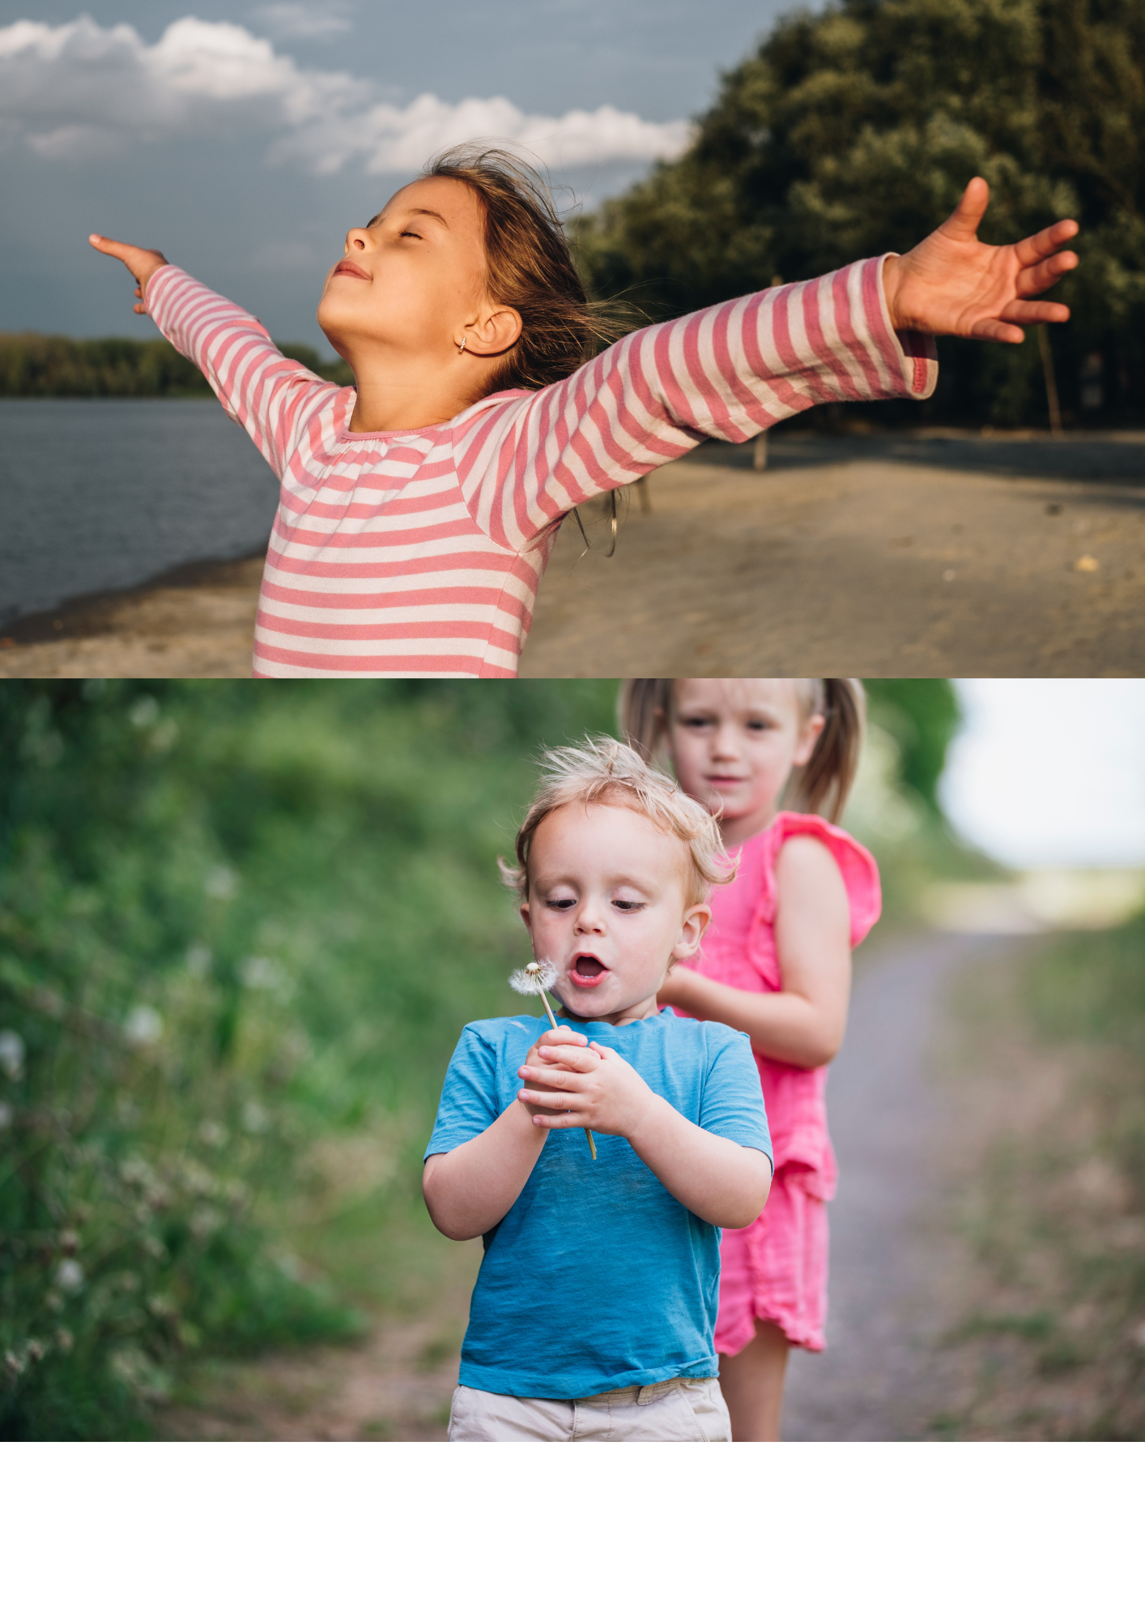
Take a deep breath...
Did you know...?
Every day, we breathe in and out about 22,000 times! We breathe a special gas into our lungs. We can't live without it.
Do you know what the gas our bodies need to live
is called?
We can't see oxygen but it's in the air all around us.
Do you know where we get oxygen from?
Let's find out on the next slide.

Slide 3
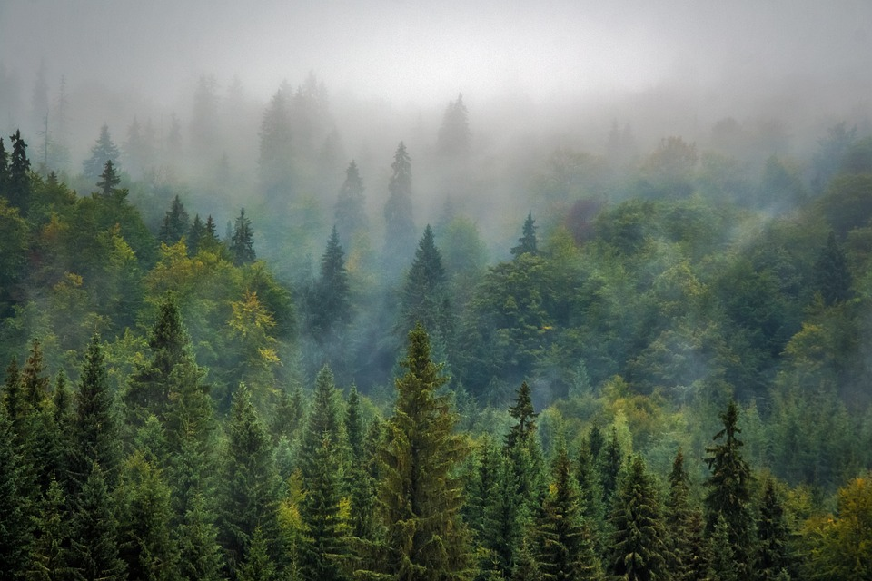
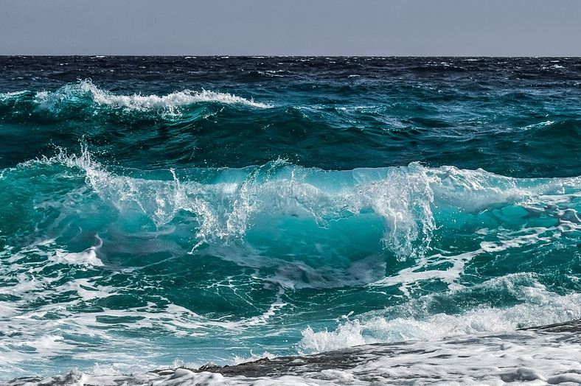
Where does oxygen come from?
About 20% of Earth's oxygen comes from trees and plants on the land.
Most of Earth's oxygen, however, comes from the ocean.
It feels great to take a deep breath of fresh, clean air!

Slide 4
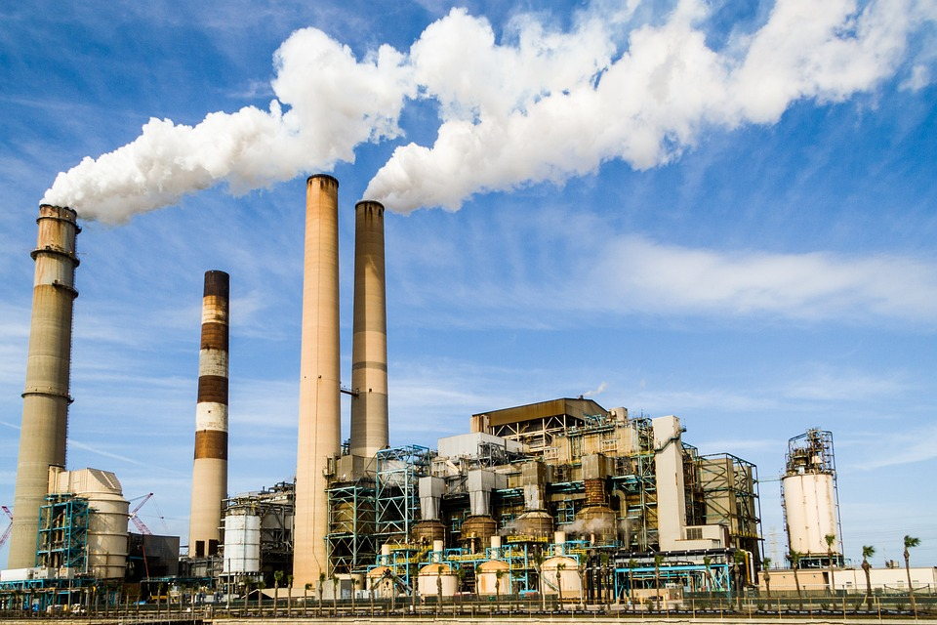
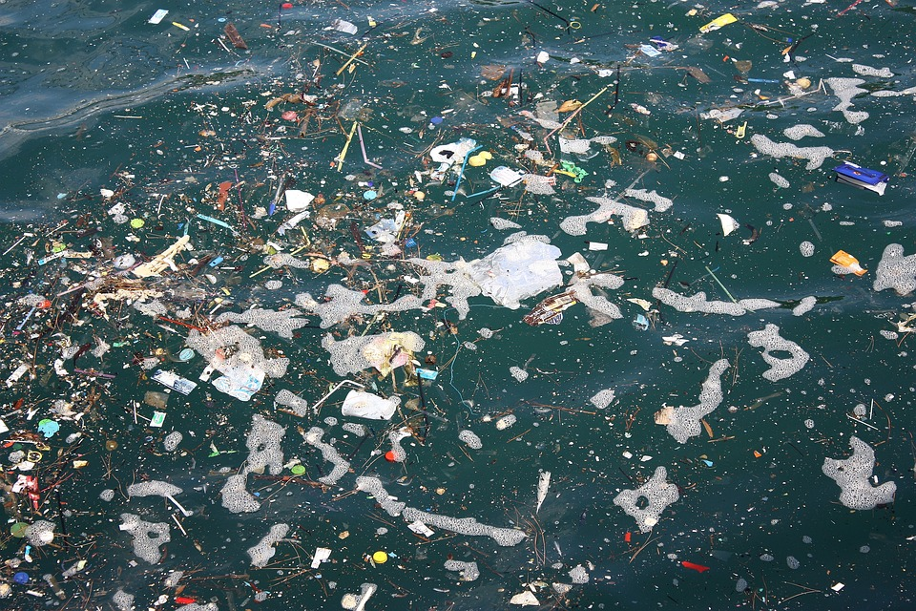
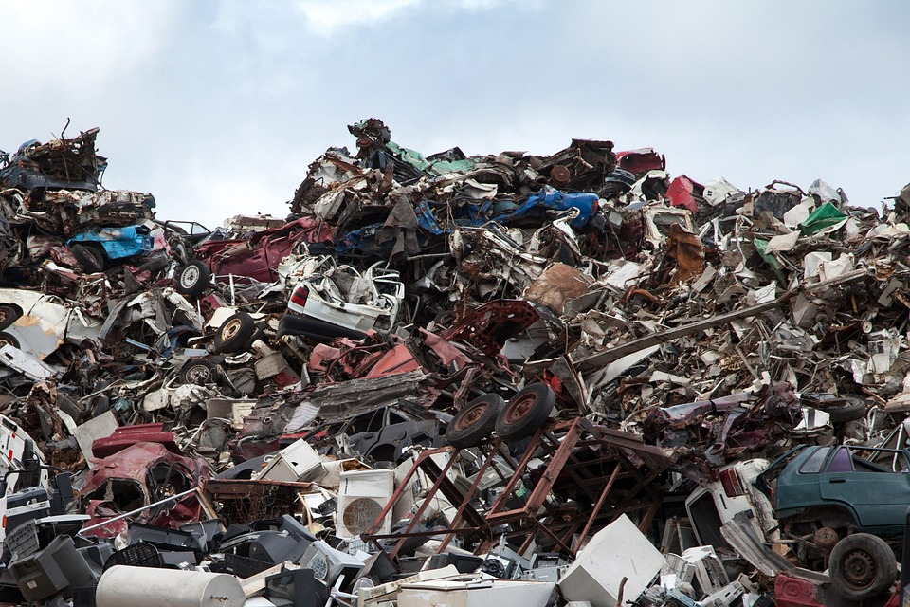
What Is pollution?
But we can't always breathe in fresh, clean air.
Planet Earth has been polluted in different ways, including the air we breathe.
Can you use these pictures to help you identify different types of pollution?

Slide 5

Types of pollution

Slide 6
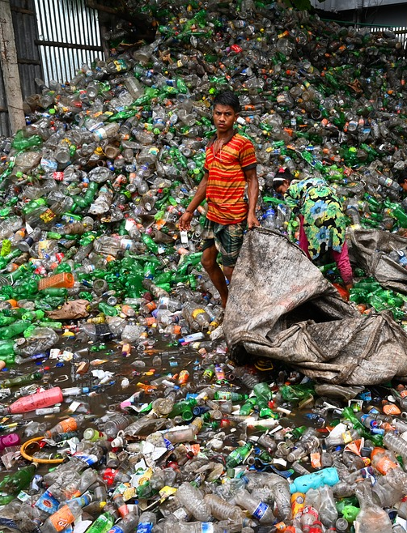
Sadly, a lot of rubbish ends up as landfill. This pollutes the land, below ground level and on the earth's surface.
The solid and liquid waste contaminates the soil and groundwater.

Slide 7
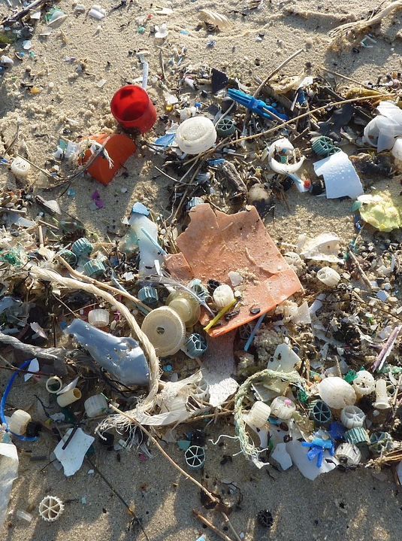
Marine pollution (or sea pollution) is a combination of rubbish and chemicals. It causes great damage to the wildlife that lives in the ocean and a lot of the rubbish washes up on our beaches.

Slide 8
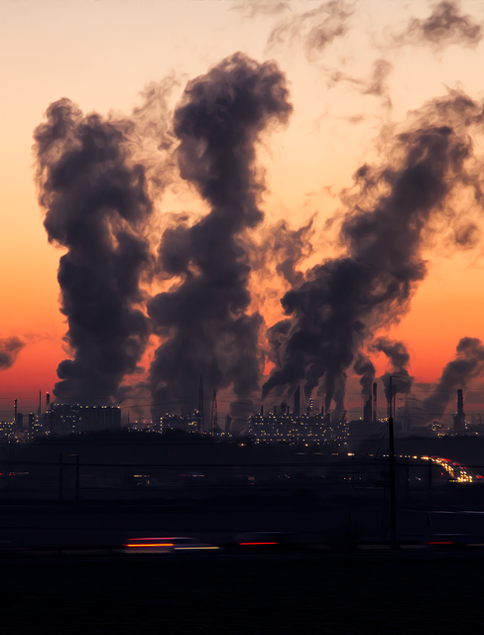
Air pollution is particles of harmful substances being released into the air that everyone on planet Earth breathes in.

Slide 9
What causes
air pollution?

Slide 10
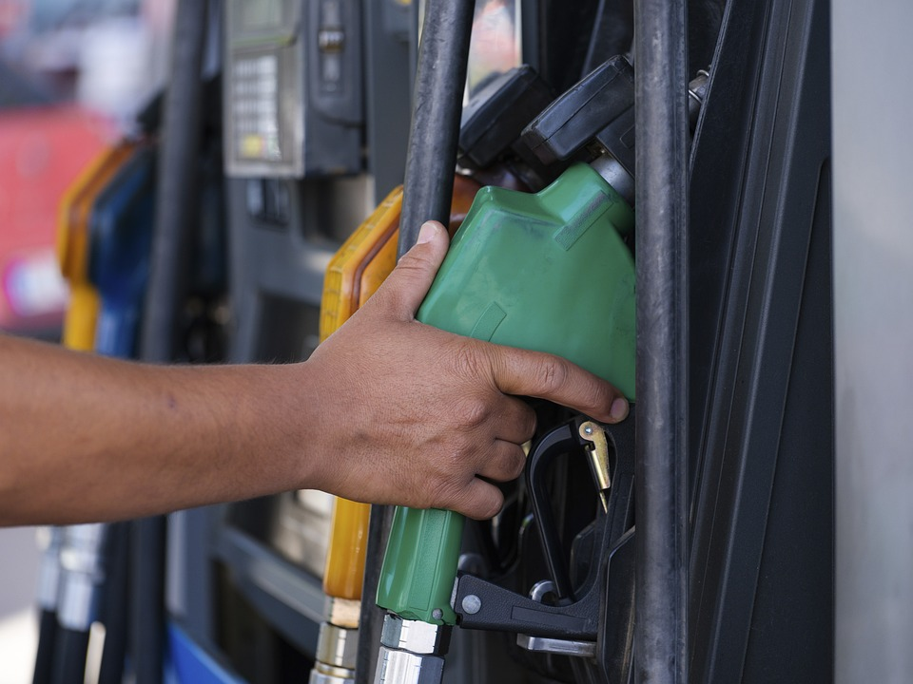
Burning fossil fuels
Fossil fuels are coal, oil and natural gas. We burn these to create heat, to power engines and to generate electricity. When we burn fossil fuels, harmful particles are released into the air.

Slide 11
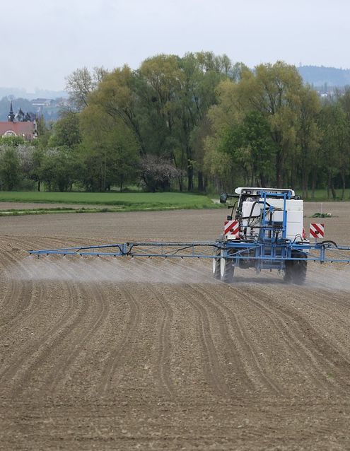
Releasing chemical pesticides
Pesticides kill pests, such as insects, rodents, and weeds, that damage farm crops. These chemicals can also damage the quality of the air we breathe.

Slide 12
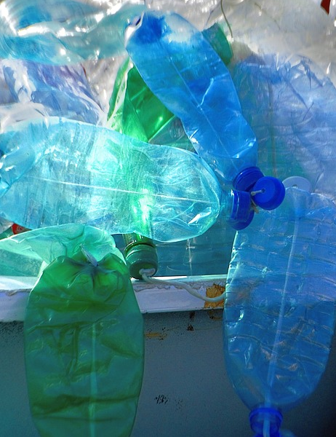
Plastic pollution
Searching for oil and gas to make plastic puts huge amounts of pollutants into the air. Many plastics aren't recycled, so they are burnt instead. This releases toxic matter into the air that we then breathe in.

Slide 13

The problem with air pollution
We all need clean air to stay healthy, but almost everyone breathes some dirty air. This polluted air is a big problem for our health.
Air pollution affects everyone, but it can be especially hard for people with asthma or other lung problems. It’s also more harmful for children because their lungs are still growing and developing.
In 2025, around 7.2 million people are living with asthma.
Worldwide, air pollution shortens the average life expectancy by 2.2 years.

Slide 14
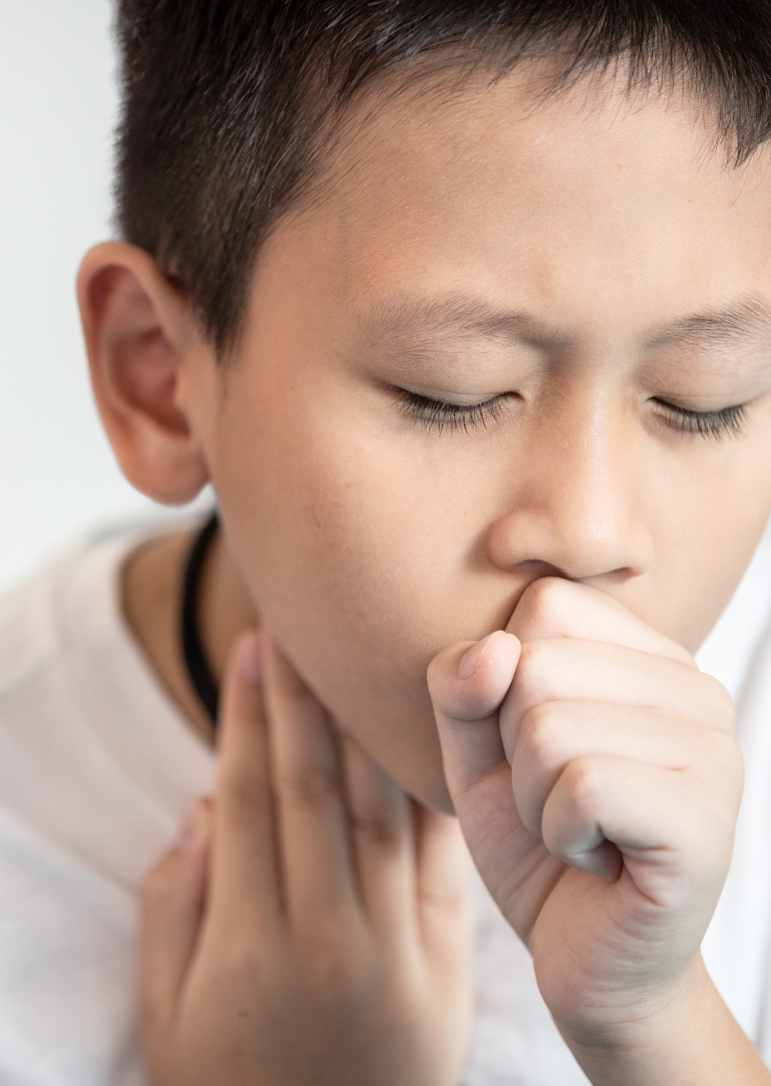
The effects on our bodies
When we breathe in polluted air, it goes into our lungs.
Polluted air can make it hard to breathe and cause a tight chest, coughing, or wheezing (a whistling sound from the chest). For some people, this can trigger an asthma attack.
Air pollution can irritate and inflame our lungs. Breathing it in for a long time can increase the risk of serious conditions like asthma, COPD, lung cancer, and reduced lung function.

Slide 15

Air pollution
around the UK

Slide 16
Air pollution is worse in some parts of the UK than others
Big cities like London, Manchester and Birmingham have more polluted air.
Can you think why large cities might have more polluted air than small villages in the countryside?

Slide 17
Air pollution
around the World

Slide 18


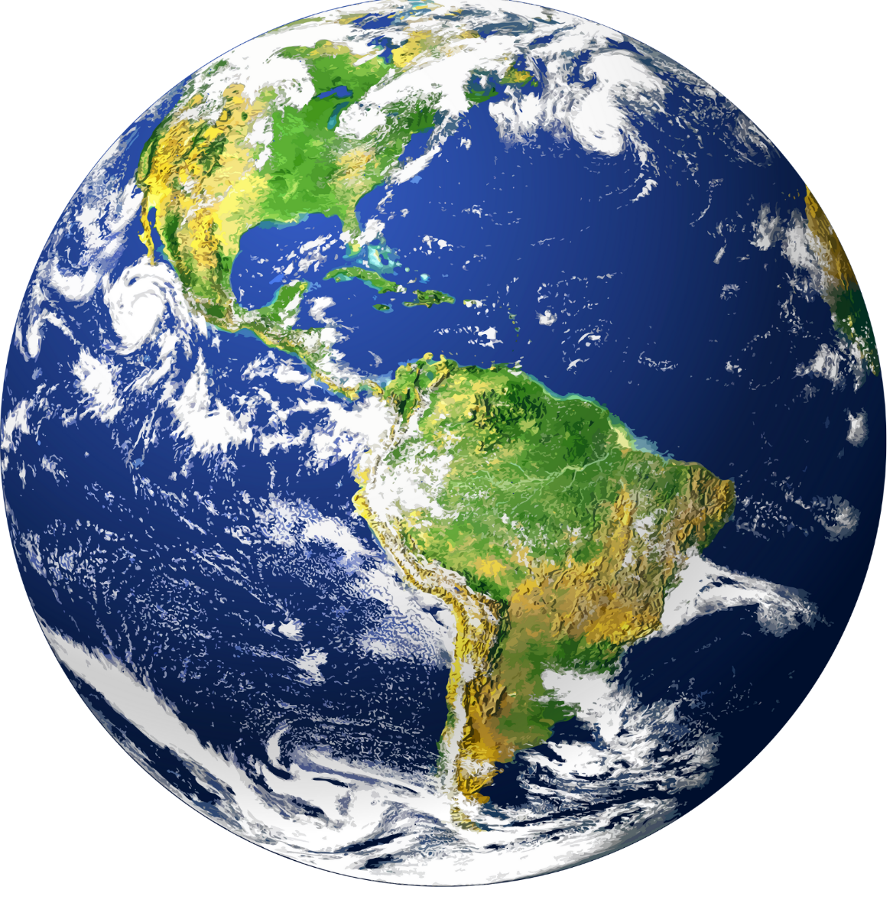
In 2014, China adopted a range of clean air measures, cutting air pollution by around half and regaining two years of average life expectancy.
36% of countries, representing nearly one billion people, are not currently monitoring their air quality.
Air pollution kills more people than tobacco worldwide.
Air pollution is one of the largest environmental threats to human health worldwide.
Over half the countries worldwide do not have an air quality standard.

Slide 19
A clean air future

Slide 20
What do you think a clean air future would look like?
What would it feel like?
What difference would it make to people's lives?
A clean air future is possible, if we all work together.

Slide 21

What is
Clean air day?

Slide 22

Every year, in June, hundreds of thousands of people take part in events up and down the UK to campaign for cleaner air.
Communities, businesses and schools learn more about pollution and changes we can all make.
Clean Air Day is very important to health organisations and charities like Asthma + Lung UK.
If more people know about pollution and help to reduce it, we can all help those with lung conditions to live healthier, happier lives.

Slide 23
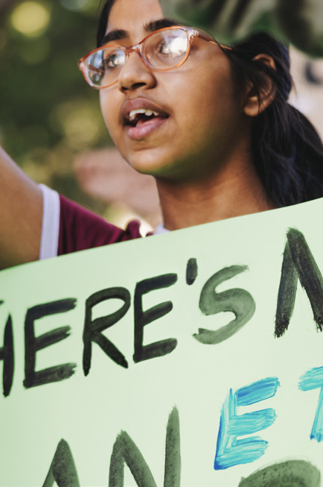
Make every day a clean air day!
Pollution is a big problem, but that doesn't mean we can't do something about it.
Little changes can make a big difference.
The government and big companies can make changes that will have a big impact.
We can all make small changes that add up to having a big impact when we all work together. Let's take a look at things we can all do...

Slide 24
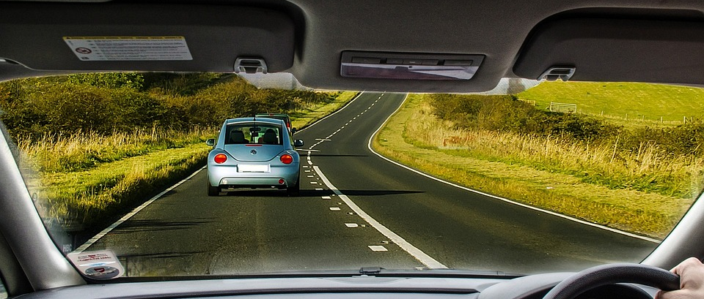
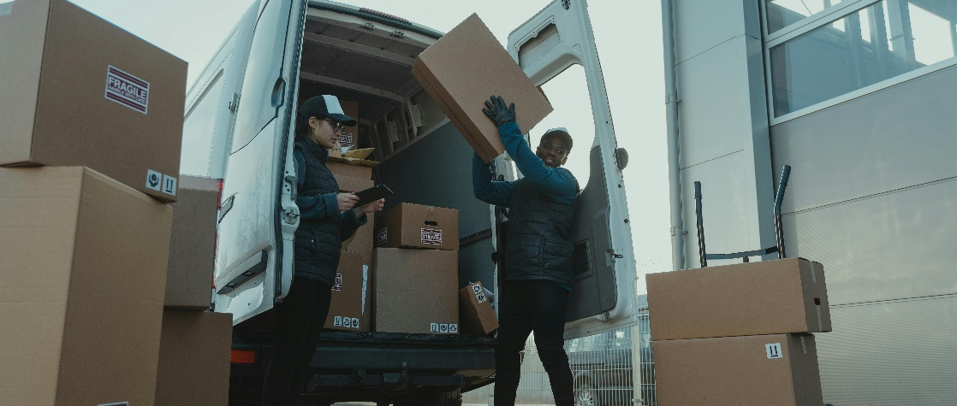
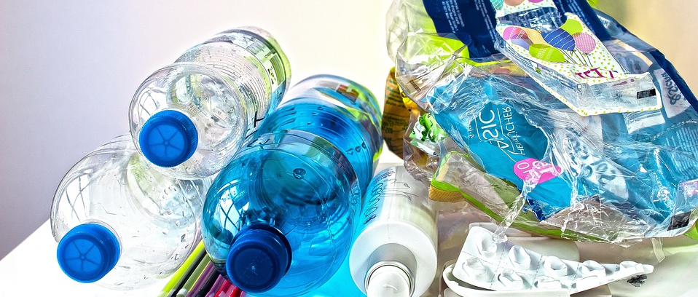
Reduce your air pollution footprint
We all have an air pollution footprint. It's a way of measuring how much our actions contribute to air pollution. Lots of things contribute to our air pollution footprint.
Every journey we make in a car.
Every order we place online that is delivered by a van.
Every time we put the gas heating on in our home.
Every time we buy plastic that can't be recycled.
Every time we throw something away that could have been reused or recycled.

Slide 25
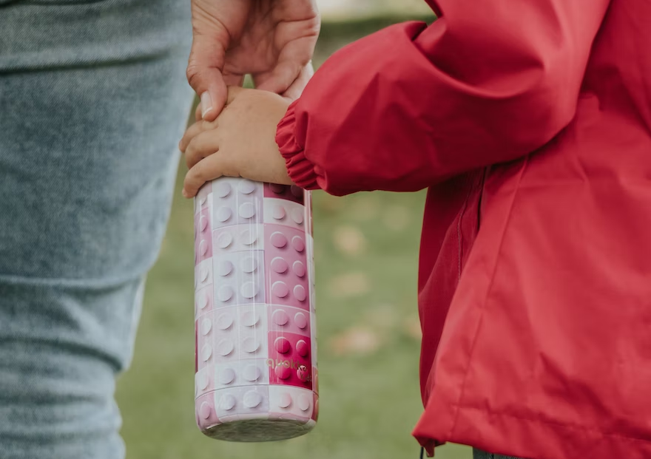

Make some changes
Try to make some simple changes to help the environment.
Use a refillable water bottle.
Walk, skate, scoot or ride your bike instead of using the car for shorter journeys.
Wrap up warm rather than turning up the heating.

Slide 26
Talk about
The more you know about how important clean air is for us all, the more you can spread the word to others!
Tell family members, friends and the community about air pollution and how we can all help to reduce it.
You can start by telling someone about this assembly when you get home tonight.
Together, we can all make a difference.
Clean Air Actions

Slide 27
Let's all do our bit to make the air cleaner.

