Slide 1
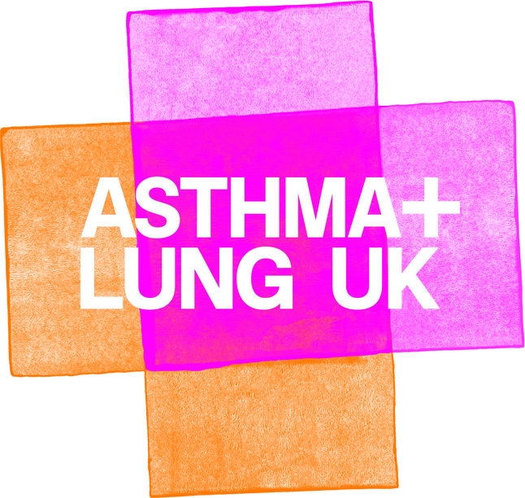


Slide 2






What is the purpose of signs like these?
Think about how these signs might influence your behaviour.

Slide 3
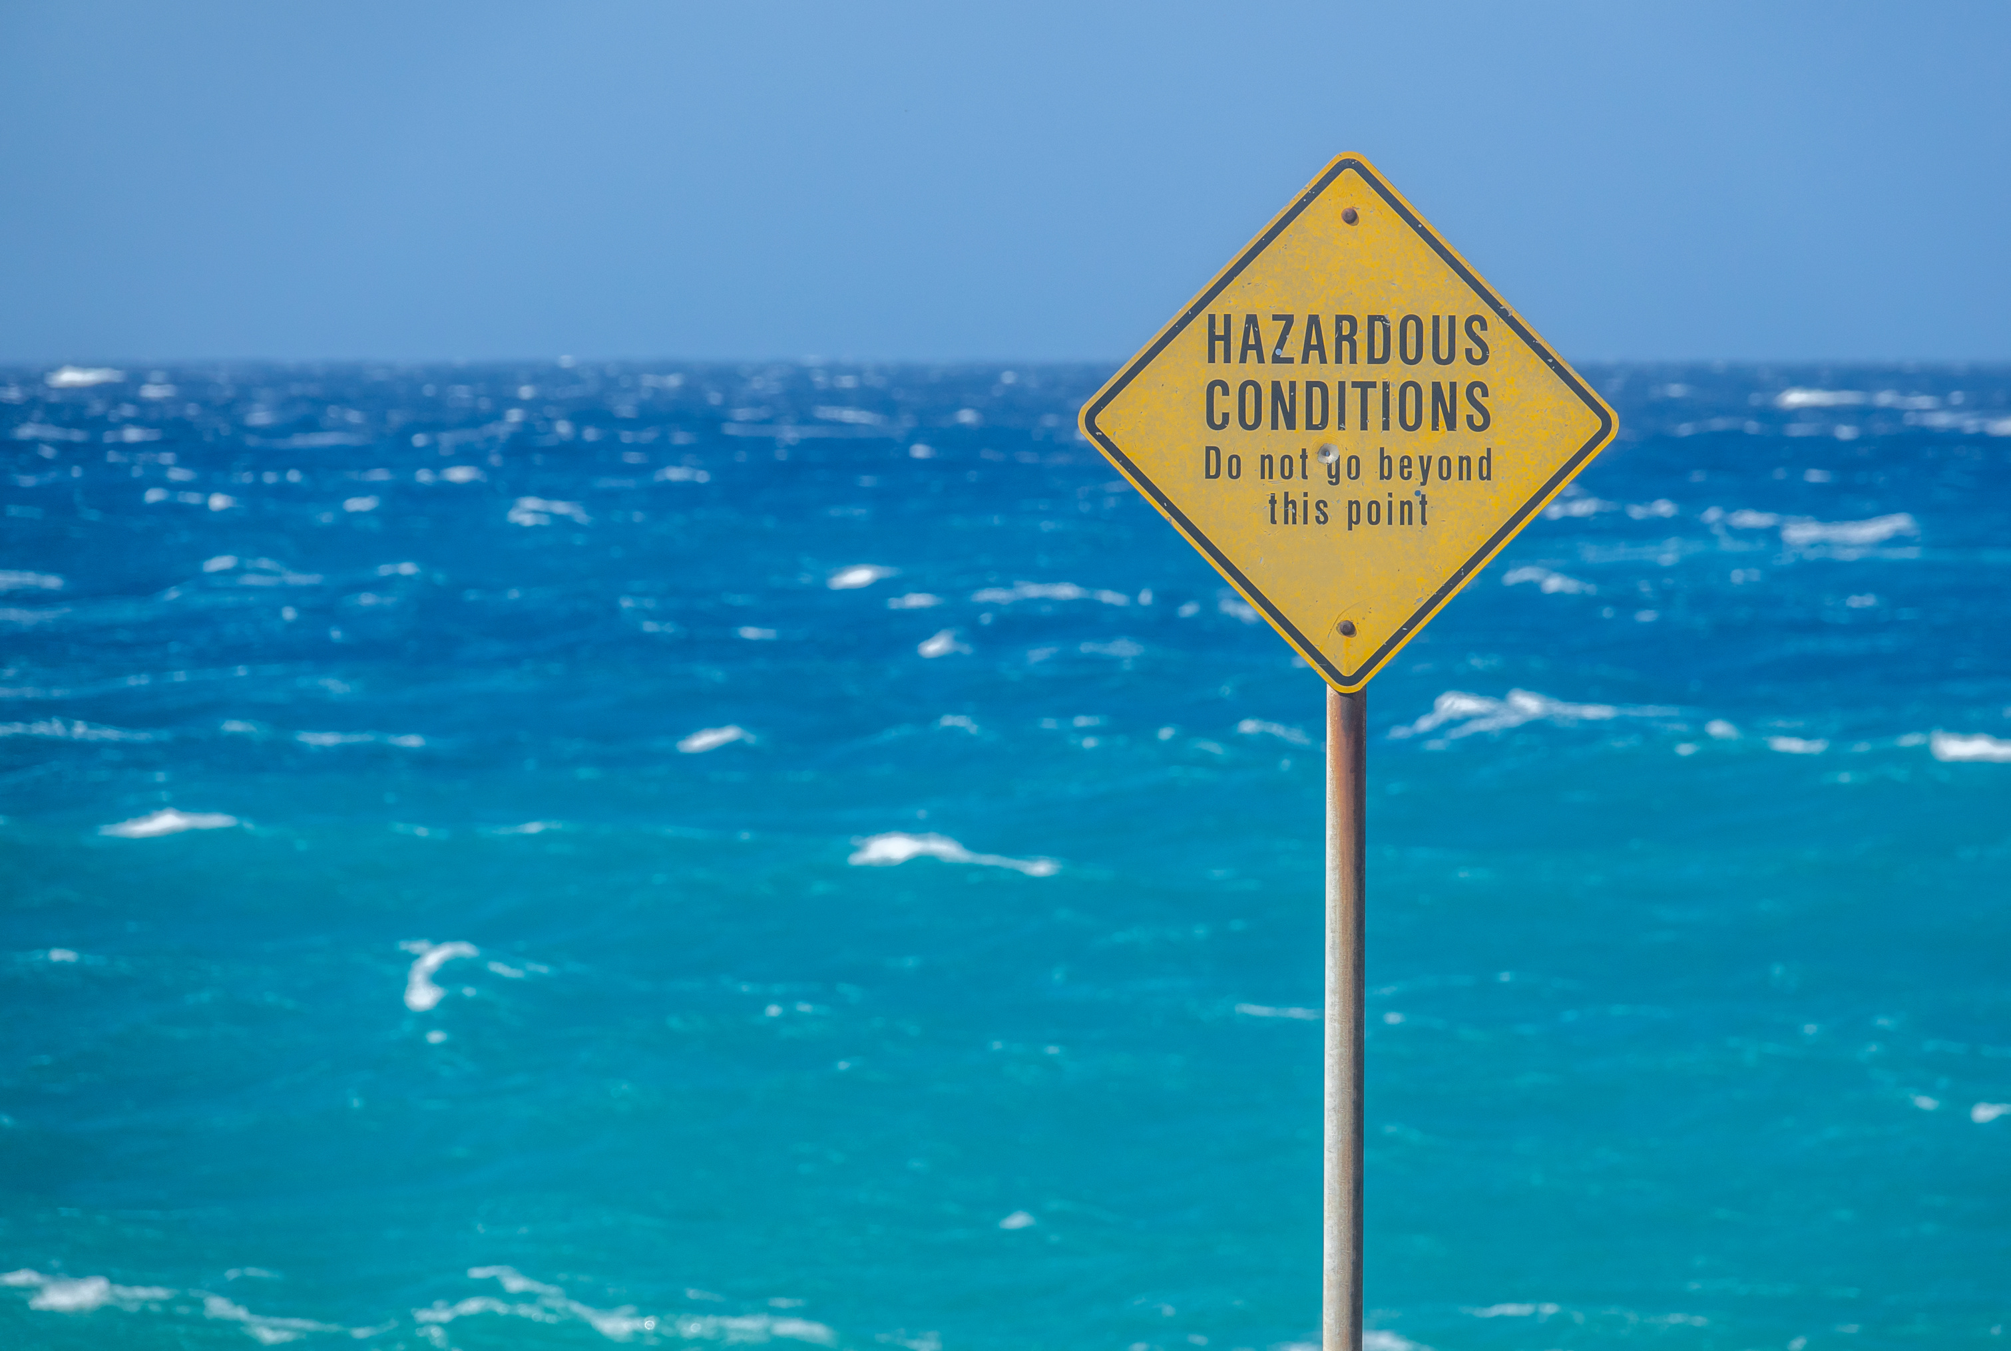
The world can be a dangerous place.
As we go about our lives, we are constantly faced with potential hazards and dangers.
Some dangers are obvious and we are frequently warned about them.
Signs such as those we have just looked at are designed to ensure those dangers are at the forefront of our minds.
They influence us to take precautions so that the danger is not so great.
However, other dangers are completely invisible and many people don’t realise they even exist.

Slide 4
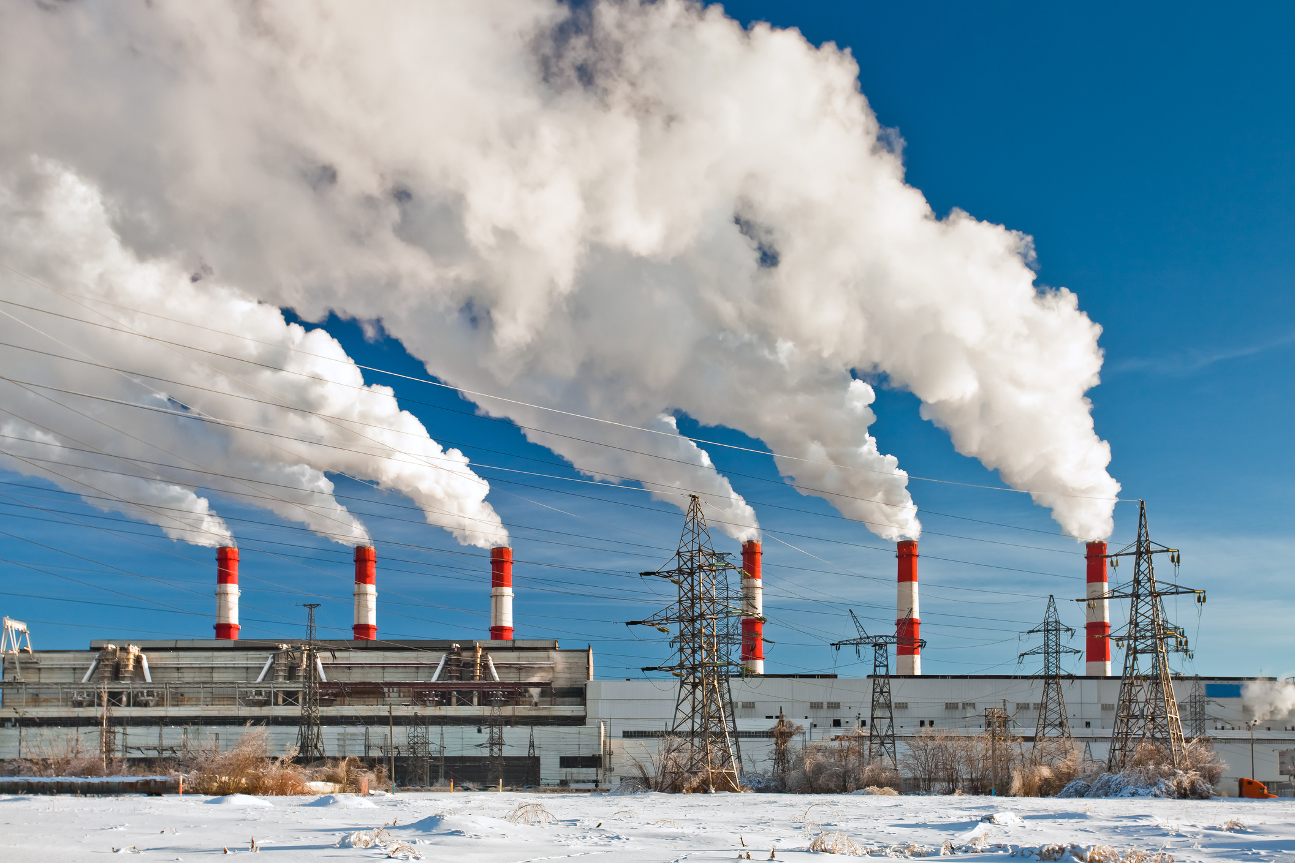
The deadly danger of air pollution
Air pollution is the single biggest environmental threat to health.
You might be surprised to learn that, currently, 99% of people breathe air that is classed as unsafe for human health.
Breathing in toxic air contributes to the early death of up to 43,000 people every year in the UK alone.
Globally, it causes 4.2 million deaths annually.

Slide 5
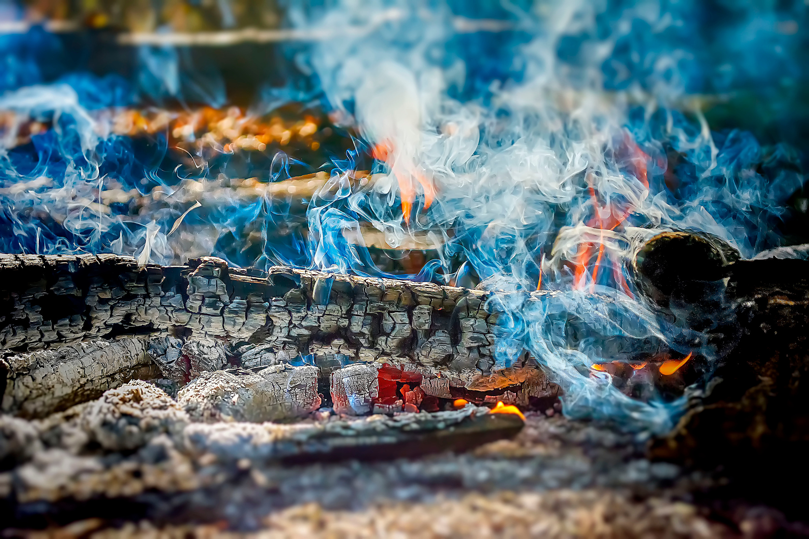
What is in our air that makes it so dangerous?
Particulat﻿e matter
One of the most dangerous forms of air pollution is called particulate matter.
These are microscopic particles that float in the air.
Have you ever seen gas coming out of an exhaust pipe or smoke rising up from a wood fire?
A lot of what you’re seeing is particulate matter.
Some particles are so small that they can seep through our skin or enter our bloodstream when we breathe them into our lungs.

Slide 6
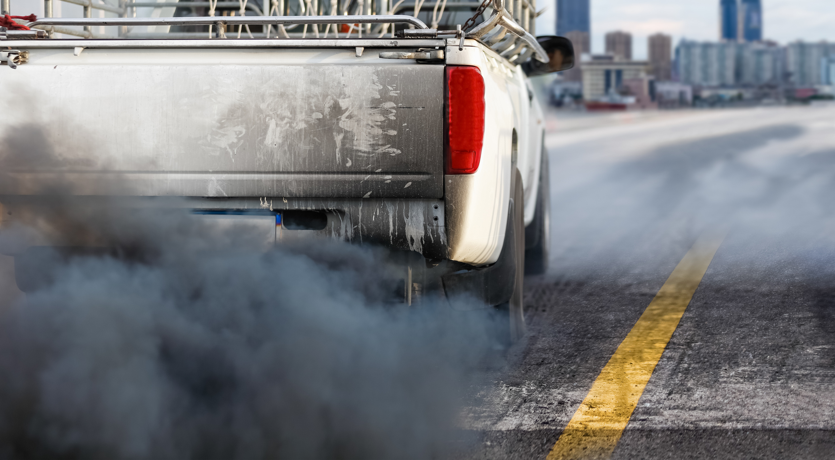
What is in our air that makes it so dangerous?
Ground-level ozone
This is created when chemicals released from fires, factories and petrol and diesel cars react with sunlight.
This photochemical reaction creates a type of particulate matter pollution that is sometimes called smog.

Slide 7
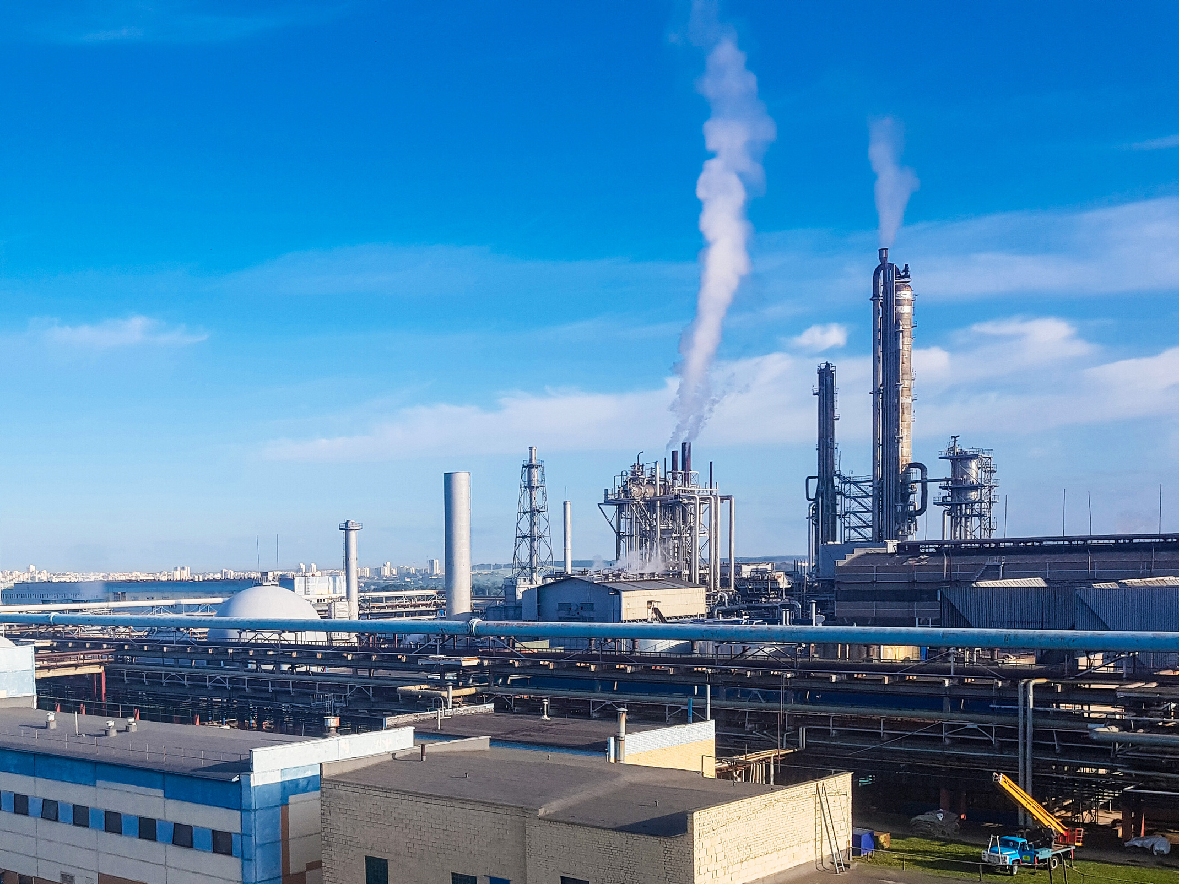
What is in our air that makes it so dangerous?
Nitrogen dioxide
This gas is created when fossil fuels are burned at high temperatures.
It is a major contributor to ground-level ozone.
The UK government estimates that over 80% of the nitrogen dioxide in our air is caused by traffic.

Slide 8


How do these pollutants affect us?
Long-term exposure to air pollution has a devastating impact on our health.
Cancer
Gastrointestinal disorders
Cardiovascular diseases
These are just some of the main conditions that are caused or made worse by toxic air:
Kidney diseases
Liver diseases
Asthma
Neurological disorders
Skin diseases

Slide 9
How do these pollutants affect us?
Even short-term exposure to air pollution can have damaging effects.
Difficulty breathing
Sore throats
These include:
Bronchitis
Pneumonia
Triggering asthma attacks

Slide 10

So what can we do about it?
We can’t stop breathing, can we?
If you were to arrive at school at 8:30 am and left for home at 3:30 pm, how many breaths do you think you would take during that time?
• Raise your hand if you think it would be around 3,000.
• Raise your hand if you think it would be around 20,000.
• Raise your hand if you think it would be around 6,000.
Those of you with your hands still up are correct, we all take around 6,000 breaths every day we spend at school.

Slide 11
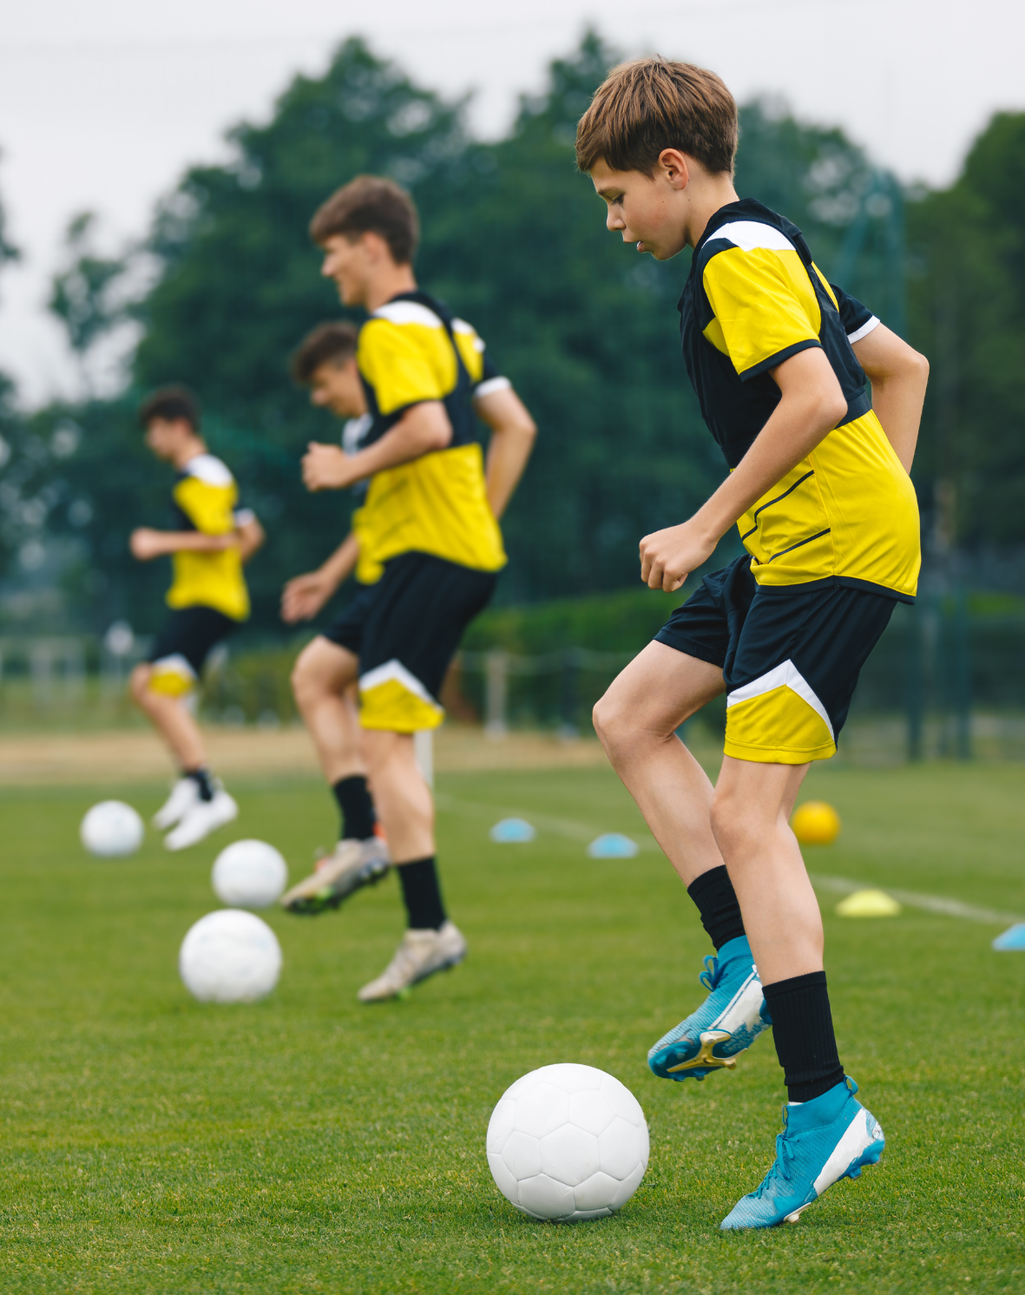
Why might the air quality in and around schools be particularly important?
1.1 million children in the UK have asthma; in fact, it is the most common long-term condition in children.
Children and young people are also more vulnerable to air pollution.
Your airways and respiratory systems are still developing and more susceptible to pollution.
Younger children are often closer to the ground and therefore closer to polluting exhaust pipes.
You are often more active than adults, which leads to rapid breathing and the intake of more polluted air.

Slide 12


This is why we are taking steps to measure the quality of the air we all breathe in school
By installing air quality monitors provided by Asthma + Lung UK, we will be able to find out exactly how polluted our air is.
We will better understand the dangers we all face. We can then use this information to influence our next steps.
This might involve raising awareness of the problem with the wider community.
By understanding the severity of air pollution locally, we will be better placed to demand change.

Slide 13
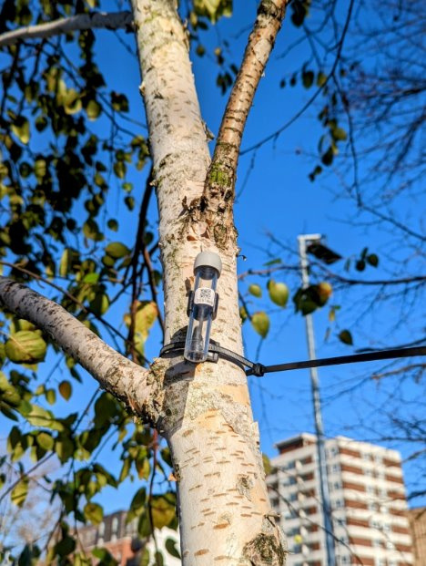
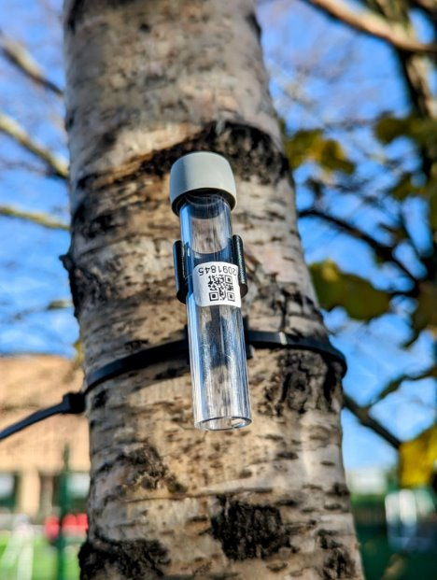
So if you see these around the school, you know what they are and that they’re here to help us.

Slide 14
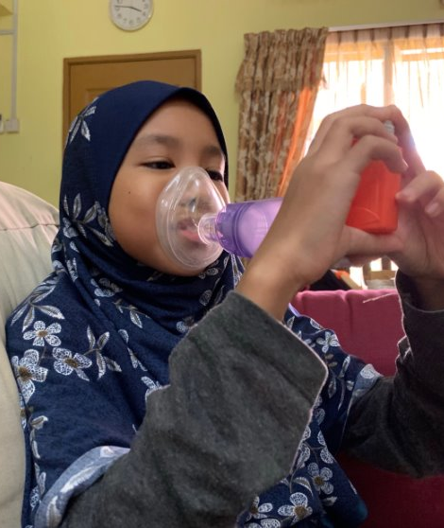
Every breath matters
Today, one in five people in the UK will develop a lung condition in their lifetime.
There are currently 5.4 million people living in the UK with asthma.
If we can get a better understanding of air pollution today, it will help us protect people from its dangers tomorrow. That way, we can all live in a world where good lung health and the ability to breathe freely are a basic right enjoyed by everybody.

Slide 15
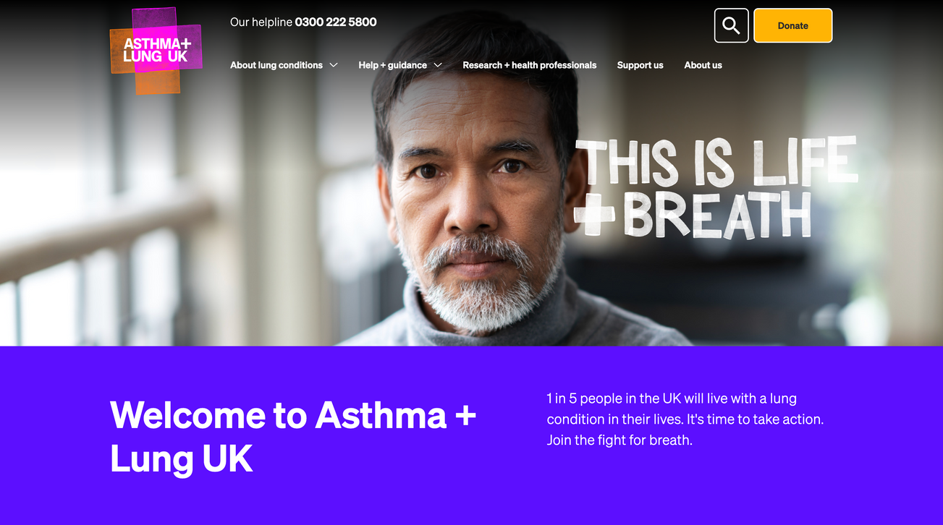
The UK’s lung health charity
It is Asthma + Lung UK’s target to reduce the number of deaths caused by lung conditions by 20% by the year 2027.
You can find out more by visiting the www.asthmaandlung.org.uk or searching #fightingforbreath on social media.

Slide 16
We believe that every breath matters

