Slide 1
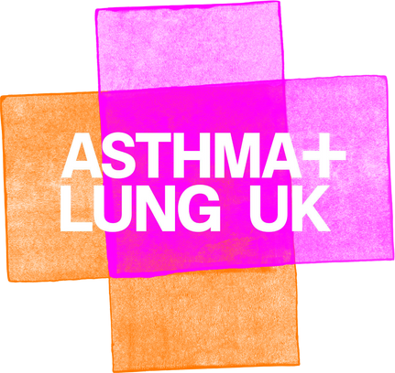


Slide 2


Starter
Look at your starter sheets
These are the six stages of how oxygen is extracted from the air - but they are in the wrong order.
Number them in the order in which they occur.

Slide 3


Starter
Number | How does the body extract oxygen from the air?
 | The bronchi then divides into many tubes that are called bronchioles
 | A network of capillaries surround the alveoli and allow oxygen and carbon dioxide to be exchanged
 | Air enters the lungs through the windpipe or trachea
 | The process of these two gases being exchanged is called diffusion and the oxygen molecules are carried by red blood cells
 | The bronchioles divide into air sacs called alveoli. In total, the lungs contain mullions of alveoli.
 | The trachea is divided into two tubes called bronchi.

Slide 4

The correct order!
Number | How does the body extract oxygen from the air?
1 | Air enters the lungs through the windpipe or trachea
2 | The trachea is divided into two tubes called bronchi.
3 | The bronchi then divides into many tubes that are called bronchioles
4 | The bronchioles divide into air sacs called alveoli. In total, the lungs contain mullions of alveoli.
5 | A network of capillaries surround the alveoli and allow oxygen and carbon dioxide to be exchanged
6 | The process of these two gases being exchanged is called diffusion and the oxygen molecules are carried by red blood cells

Slide 5


Learning objectives:
To identify the different stages of how the human body removes oxygen from the air.
To describe the different types of air pollution.
To explain how air pollution affects the human body.

Slide 6

Breathing - it’s vital to life.
We all do it. All day and all night.
On average, we breathe in and out 22,000 times a day and it is how we access our body’s life-sustaining gas - oxygen.
Unfortunately, due to air pollution, we also breathe in and absorb things that are the very opposite of life-sustaining.
Air pollution comes in several different forms. Look at your 'Types of Air Pollution' sheets.

Slide 7






Draw a line between the the types of pollution and the correct definition.
This can occur naturally, from pollen or dust, but is often caused in cities by the burning of fossil fuels. This is sometimes referred to as soot and diesel engined vehicles are a major contributor of this type of air pollution. The smallest particles are less than 0.1 microns in diameter. In comparison, a human hair normally measures 75 microns across.​
Particulate Matter (PM)
These include carbon monoxide, sulphur dioxide and ground-level ozone that is sometimes referred to as smog. The burning of wood and fossil fuels such as coal and oil causes this type of pollution and ground-level ozone is created by a photochemical reaction between pollutants and sunlight. ​
Nitrogen Dioxide
Other Pollutants
Over 80% of this type of pollution in the UK is caused by transport and diesel vans and cars are the biggest polluters. City centres suffer particularly high levels of this type of pollution. There is evidence that exposure to this gas is a likely cause of asthma in children.

Slide 8
The correct answers
This can occur naturally, from pollen or dust, but is often caused in cities by the burning of fossil fuels. This is sometimes referred to as soot and diesel engined vehicles are a major contributor of this type of air pollution. The smallest particles are less than 0.1 microns in diameter. In comparison, a human hair normally measures 75 microns across.​
Particulate Matter (PM)
These include carbon monoxide, sulphur dioxide and ground-level ozone that is sometimes referred to as smog. The burning of wood and fossil fuels such as coal and oil causes this type of pollution and ground-level ozone is created by a photochemical reaction between pollutants and sunlight. ​
Nitrogen Dioxide
Other Pollutants
Over 80% of this type of pollution in the UK is caused by transport and diesel vans and cars are the biggest polluters. City centres suffer particularly high levels of this type of pollution. There is evidence that exposure to this gas is a likely cause of asthma in children.

Slide 9
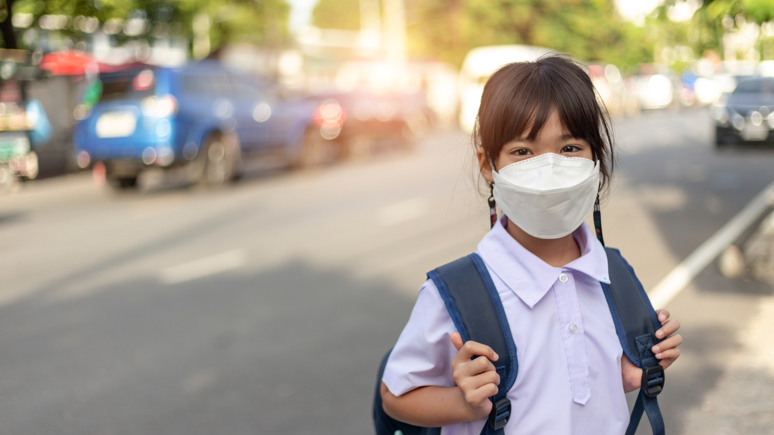
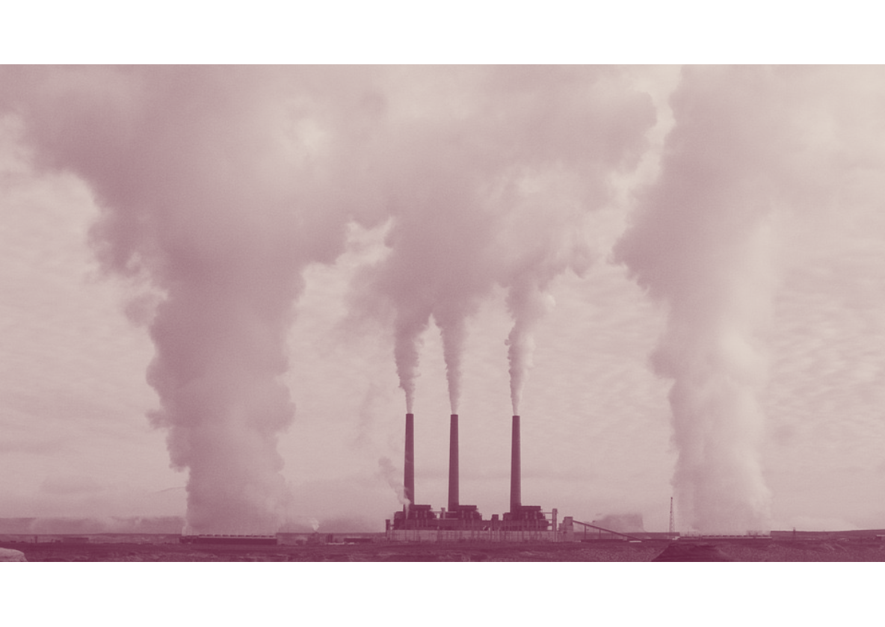
The Deadly Dangers of Air Pollution
You might be surprised to learn that, currently, 99% of people breathe air that is classed as unsafe for human health!
Breathing in toxic air contributes to the early death of up to 43,000 people every year in the UK alone. Globally, it causes 4.2 million deaths annually.
So how exactly can and does it affect people?

Slide 10
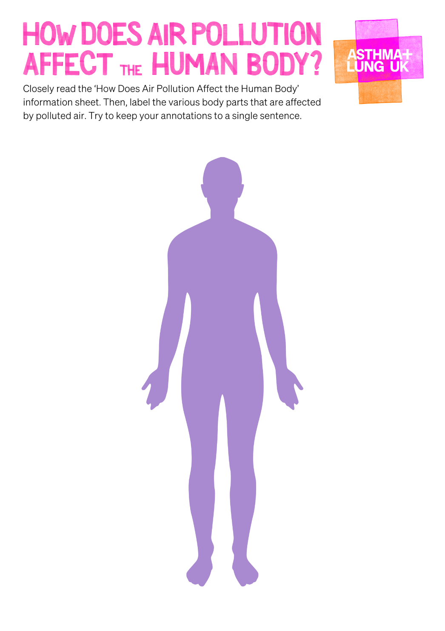
Look at your ‘How Does Air Pollution Affect the Human Body?’ Information Sheet and your figure diagram.
Your task is to closely read about all the impacts that air pollution has on the human body.
Then, summarise it in a label that points to the area of the body that is affected by the pollution.
Make sure your labels are no longer than one sentence.

Slide 11
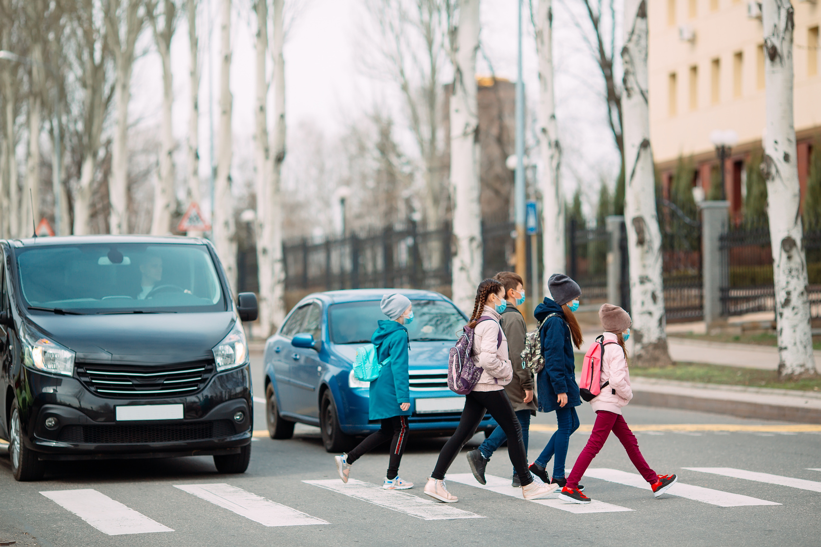
Children are at particular risk from air pollution
There are numerous reasons why children are more vulnerable to breathing in polluted air than adults:
They breathe more rapidly and therefore take in more polluted air.
They often spend more time outdoors than adults.
They are often more active than adults, which leads to rapid breathing and the intake of more polluted air.
They are normally closer to the ground and are often at the same height as exhaust pipes, whether they’re walking or in a pushchair.
Their airways and respiratory systems are still developing and more susceptible to pollution.
Which of these reasons do you think is the most important in causing children to be at increased risk from air pollution? Explain your choice.

Slide 12
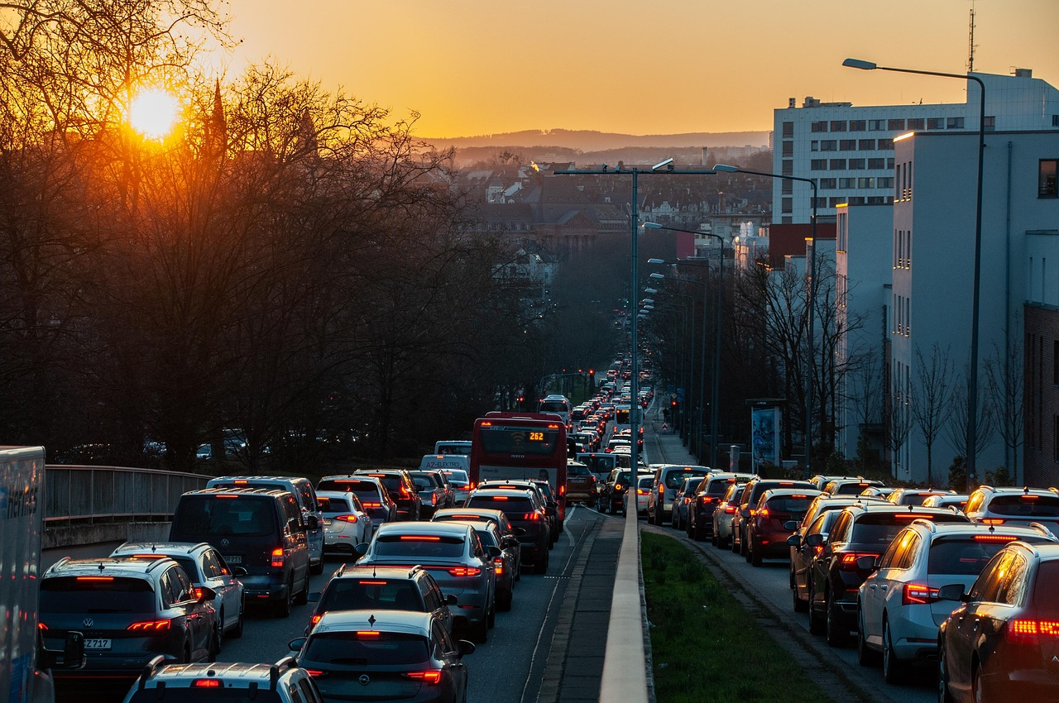
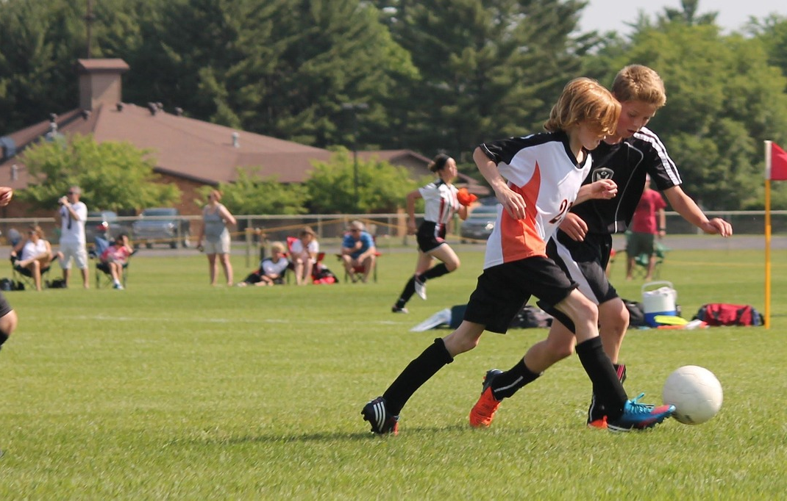
Reducing the risks
Can you suggest ways to reduce the threat that pollution poses to our lung health?
Individuals can reduce exposure to pollution by limiting outdoor activities during high pollution periods, and improving indoor air quality through ventilation and avoiding pollutants.​
Additionally, lifestyle choices like quitting smoking, staying physically active, and seeking medical advice when necessary can also help protect lung health. ​

Slide 13
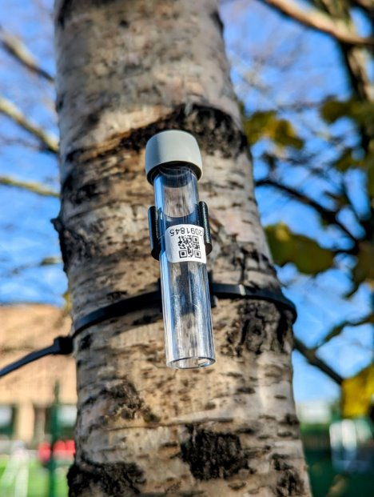

How do we know where air pollution is at its worst
One way of identifying air pollution is by using monitors.
Air quality monitors are extremely useful. Using them means people are more informed about which areas to avoid and which areas are safer. The choice of location of the monitors is very important.
If you were to install six air quality monitors outside on the school site, where would you put them?
Name all six outdoor locations and explain your thinking behind your choices.

Slide 14
Can you…
Identify the different stages of how the human body removes oxygen from the air?
Describe the different types of air pollution?
Explain how air pollution affects the human body?

Slide 15
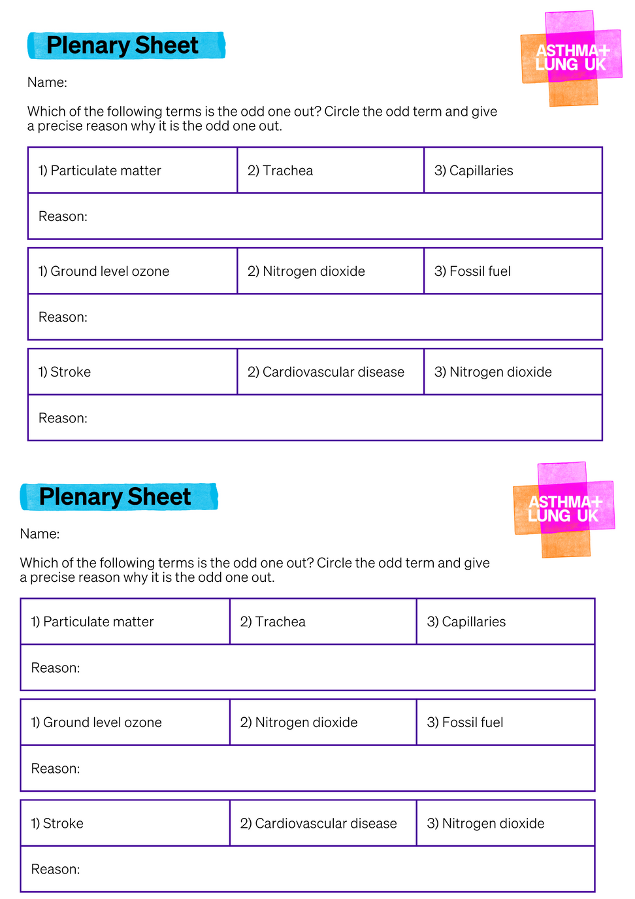
Plenary
Look at your sheets.
There are three groups of three terms that we have looked at in today’s lesson.
Your job is to identify the odd one out in each group.
Circle the odd term and give a precise reason why it is the odd one out.
Make sure you put your name on the sheet.

Slide 16
Breath is an inhalation, an exhalation. Breath is life.
We’re the UK’s lung health charity, fighting for your right to breathe.

