Slide 1
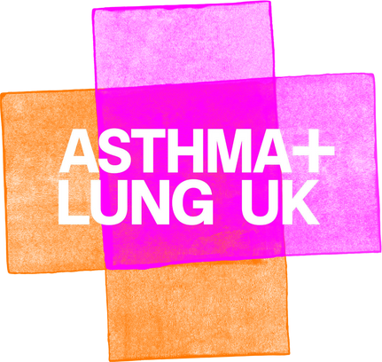


Slide 2







Starter activity
Look at these hazard signs. What dangers are they warning you about?
Write numbers 1 to 5 in the margin and try to name the hazard each symbol represents.

Slide 3

The correct answers
Dangerous or corrosive chemicals
Flammable materials
Explosive materials
Radiation
Danger of electrocution

Slide 4


Learning objectives:
Describe the key features of the three main types of air pollution.
Make a judgement over which is the most dangerous type of air pollution.
Explain why air monitors are so important in improving air quality and reducing lung disease.

Slide 5

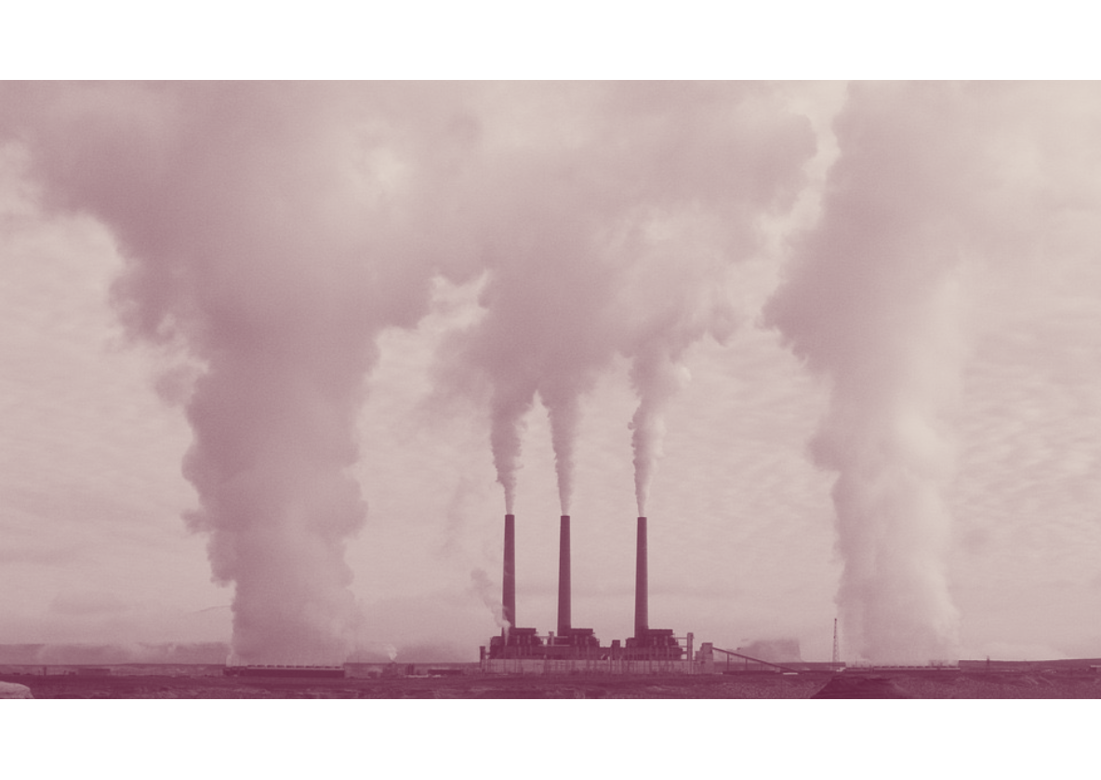
Invisible dangers
The dangers highlighted by those signs are all fairly well-known and the dangers they represent are fairly clear.
What many people don’t realise, is that air pollution is a real and growing danger.
Currently, 99% of people breathe air that is classed as unsafe for human health.
The impact of breathing in toxic air is devastating and contributes to the early deaths of up to 43,000 people every year in the UK alone.
So, what causes air to become unsafe for human health?

Slide 6


Working with the person next to you, create a mind map that identifies as many different contributors to pollution or toxic air as you can.
Pollutants

Slide 7

Sources of air pollution include…
Burning fossil fuel to create electricity in power stations.
Transport in the form of planes, diesel-powered trains and petrol and diesel-powered cars.
Factories, manufacturing and the construction industry
Agriculture in the form of growing crops and raising animals like cows and sheep.
Heating homes either through gas-fired central heating boilers or wood-burning stoves.

Slide 8
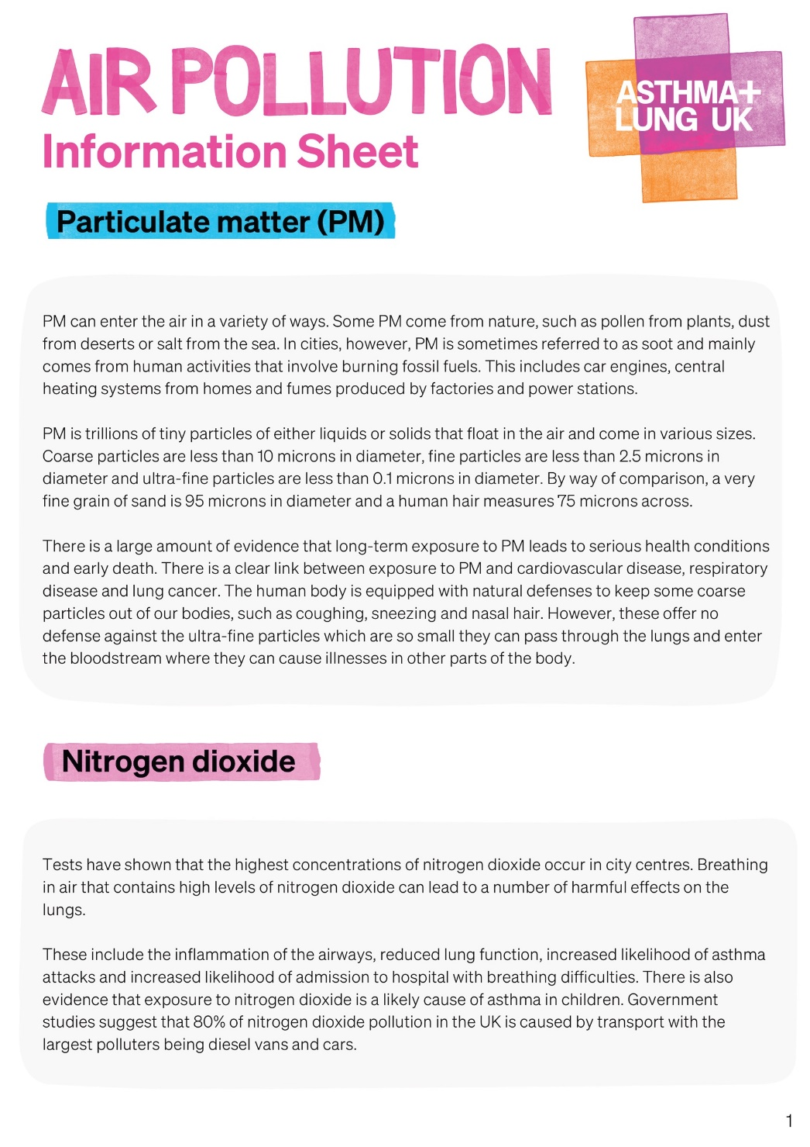
How does this impact the air?
There are three main ways in which these human activities affect the air we breathe.
• Particulate matter (PM)
• Nitrogen dioxide
• Other pollutants
Now look at your Air Pollution Information Sheet.

Slide 9

First, closely read the section on
Particulate matter (PM)
• In your books, define what particulate matter is.
• Explain where it comes from.
• Identify the names and sizes of the three main types of PM.
• Explain which is the most dangerous type of PM and why.
• List three medical conditions that PM is linked to.

Slide 10



Now, closely read the section on
Nitrogen dioxide
• In your books, explain what the biggest source of nitrogen dioxide is in the UK.
• List three medical effects that short-term exposure to high levels of nitrogen oxide can have.

Slide 11
All air pollution is problematic.
Particulate matter (PM)
But which do you think is the most serious problem?
Nitrogen dioxide
Place the three types of air pollution (particulate matter, nitrogen dioxide and other pollutants) in order of significance.
Explain your choice.
Other pollutants

Slide 12
“Knowledge is power.”
Francis Bacon, 1597.
Air pollution, and therefore lung disease, is not evenly distributed across the UK.
In the past, areas with the worst air quality were only identified by the number of cases of lung diseases that occurred there. Now, it is possible to measure air quality with air monitors. This means…
People who are particularly vulnerable, like children, pregnant women and those with existing health conditions, can be made aware and take steps to avoid those areas before illnesses occur.
Steps can be taken to improve the air quality, such as creating car exclusion zones, congestion charges and closing coal-fired power stations.
Clear data and hard evidence is available to help people campaign to improve the air in their area. They can then appeal to their local council, Member of Parliament or the national government to help.
In one sentence, summarise why air monitors are important in helping improve air quality.

Slide 13

In this lesson, have we…
Described the key features of the three main types of air pollution?
Made a judgement over which is the most dangerous type of air pollution?
Explained why air monitors are so important in improving air quality and reducing lung disease?

Slide 14

Plenary
Remember the hazard warning signs in the starter?
Your task now is to come up with a symbol that could be used to warn people the hazard of air pollution.

Slide 15
Breath is an inhalation, an exhalation. Breath is life.
We’re the UK’s lung health charity, fighting for your right to breathe.

